Slide 1
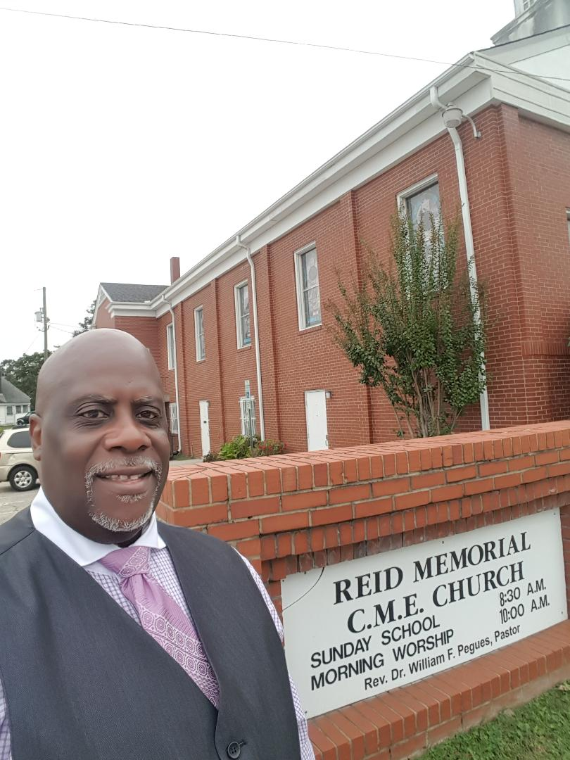

THE MAGNIFICENT REID MEMORIAL CME CHURCH
”WHERE JESUS IS LORD AND GOD IS EVERYTHING!
I appeal to you, brothers and sisters, in the name of our Lord Jesus Christ, that all of you agree with one another in what you say and that there be no divisions among you, but that you be perfectly united in mind and thought. ~ 1 Corinthians 1:10

Slide 2

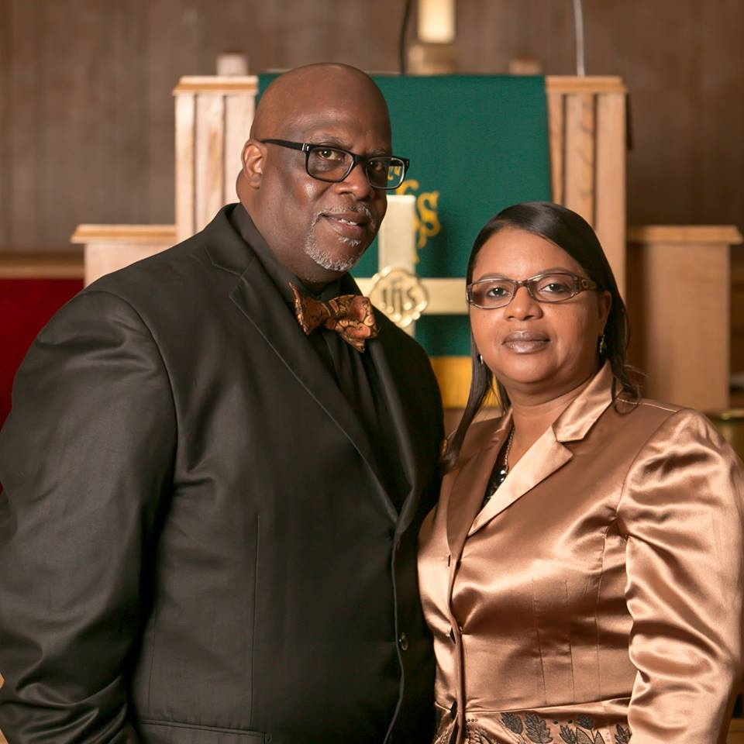
THE JOURNEY BEGINS………
Rev. Dr. William F. Pegues and First Lady Dorothy Pegues

Slide 3

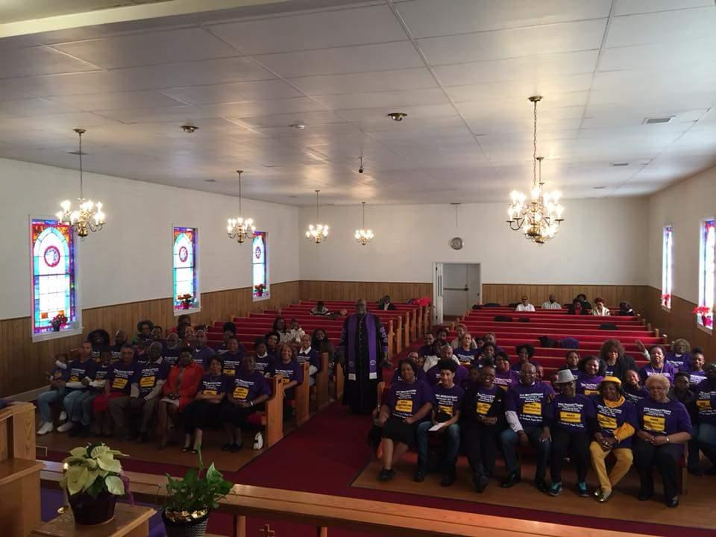
UNDER CONSTRUCTION

Slide 4
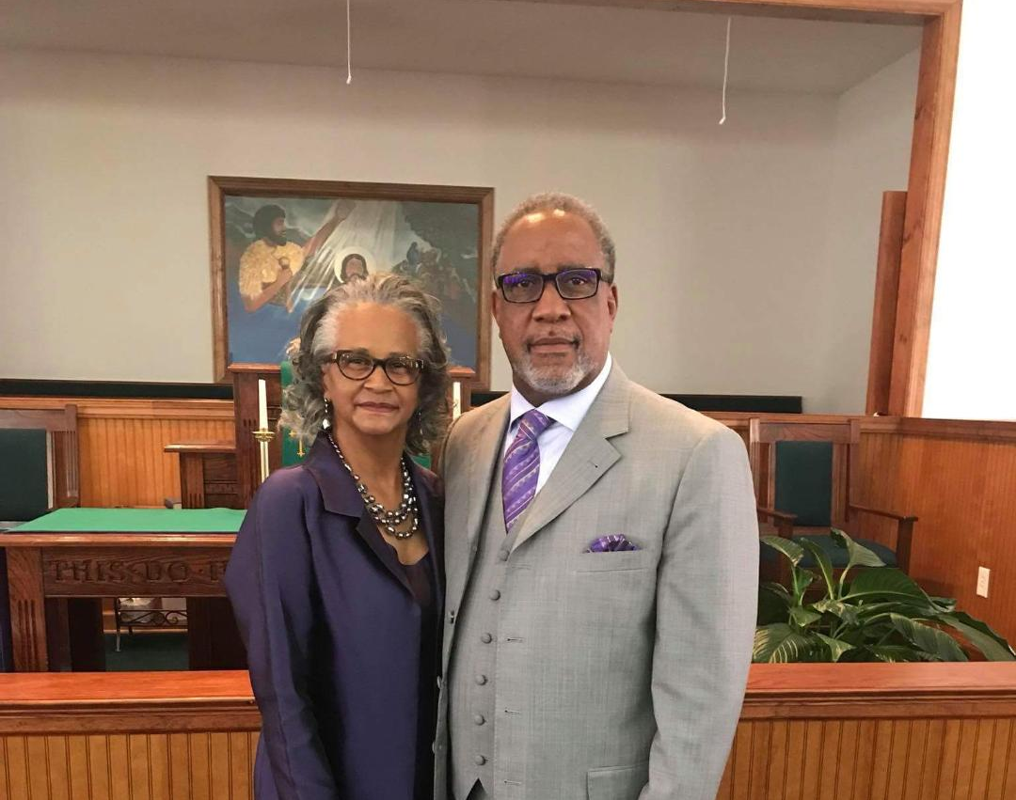
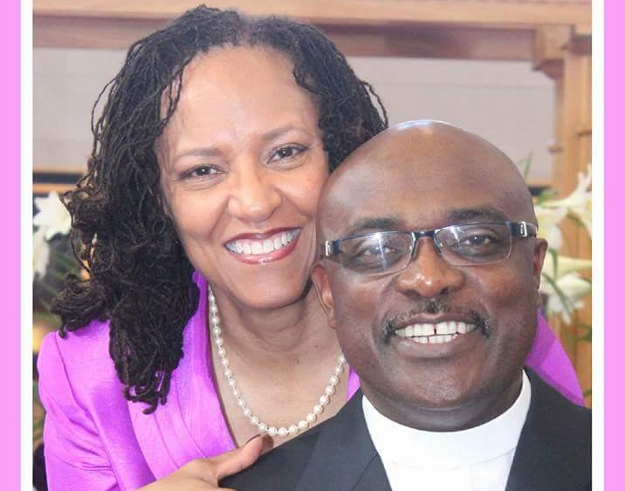
CONFERENCE RELATIONS
~Rev. Dr. Clifton E. Harris, Presiding Elder
~ Bishop James B. Walker, Presiding Prelate

Slide 5
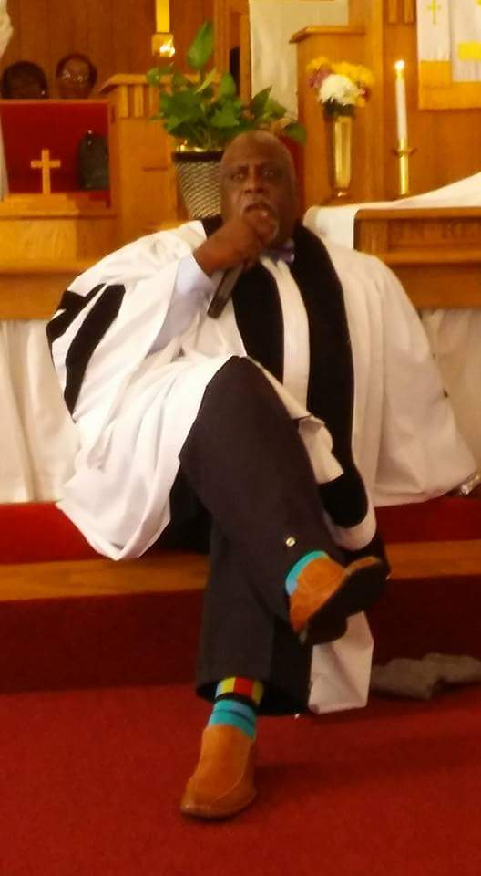
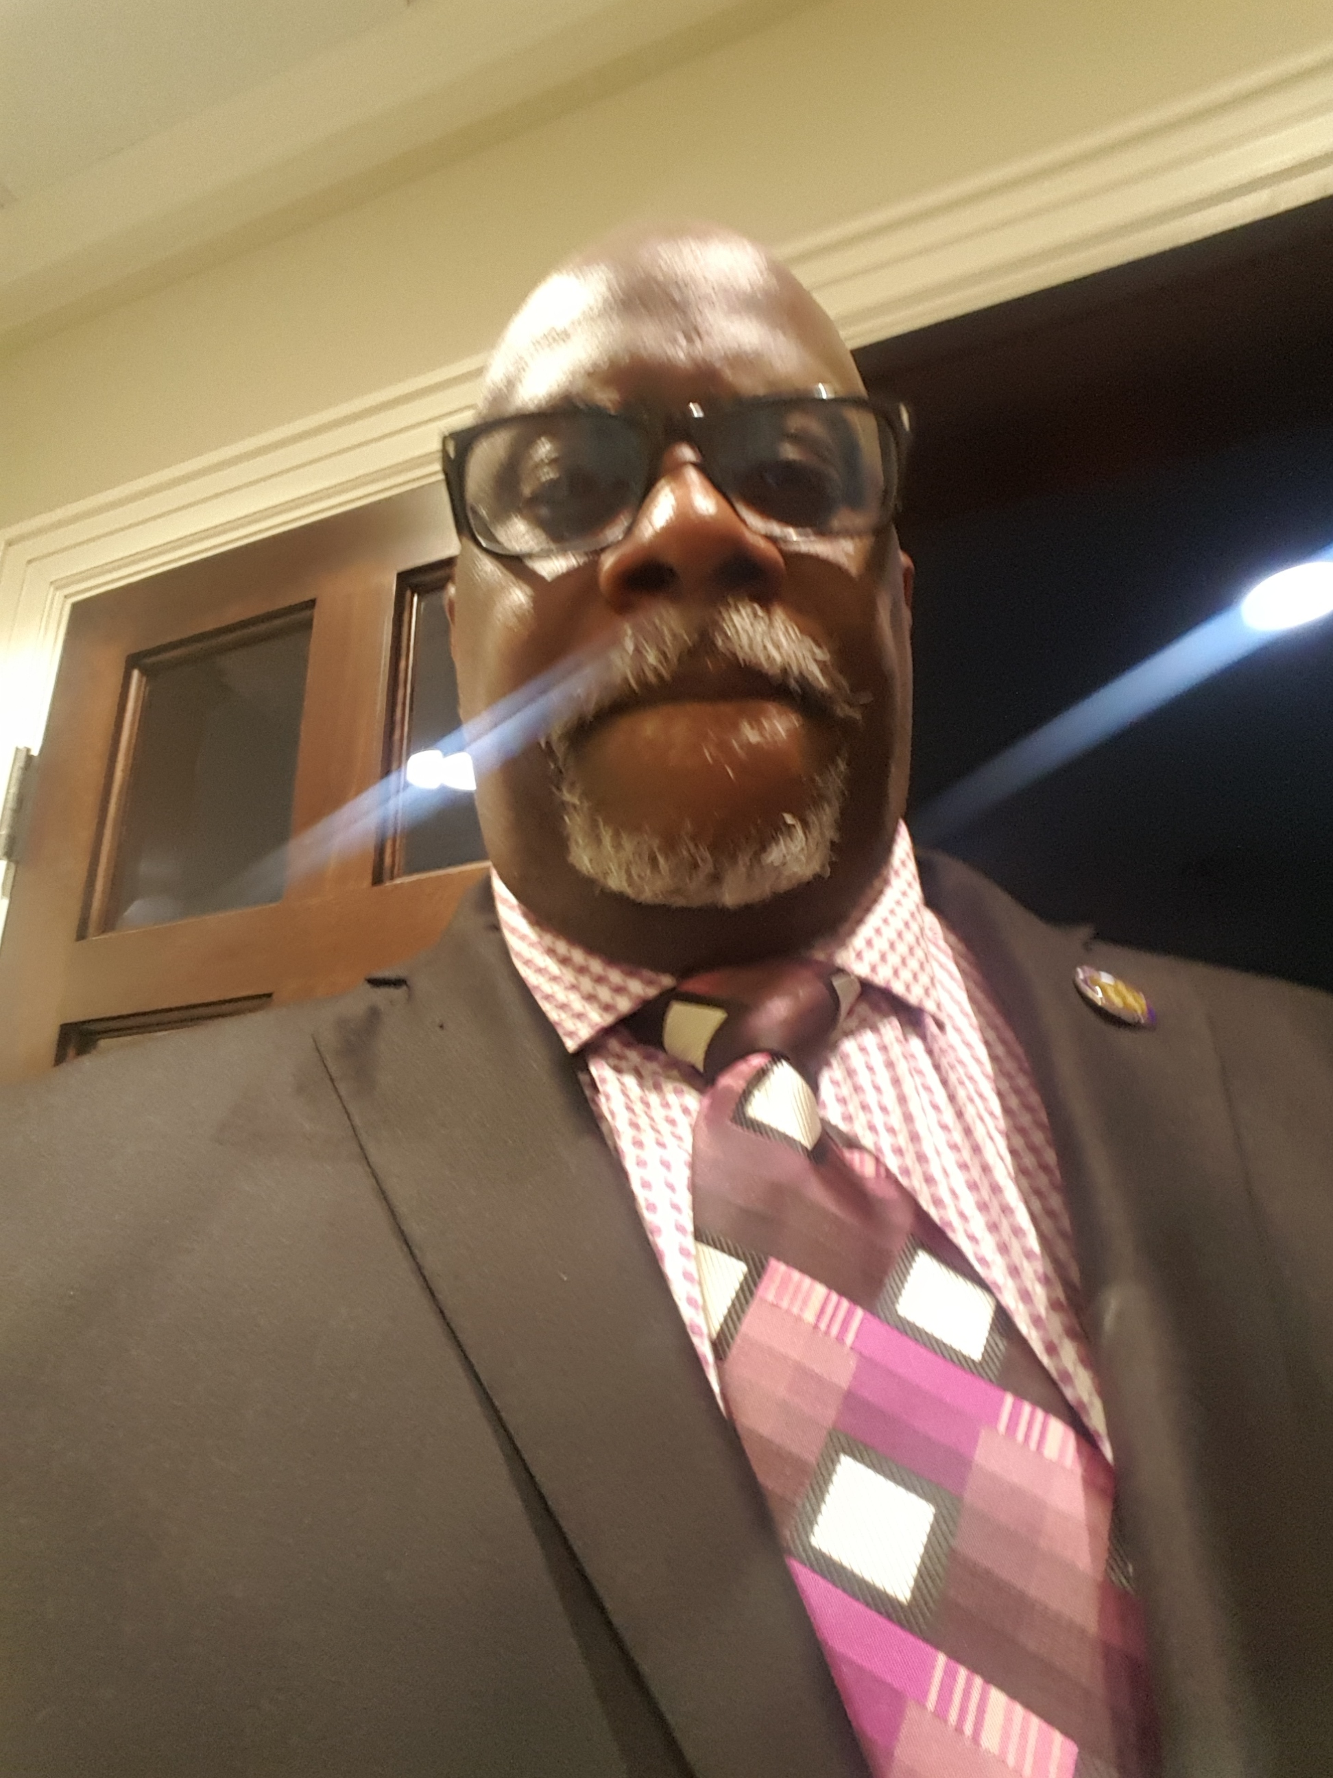
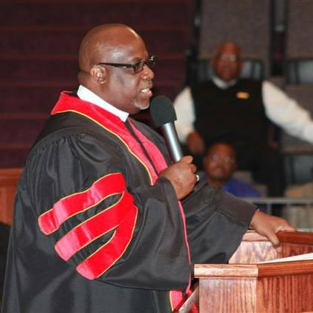
REID’S PROGNOSTICATORS

Slide 6
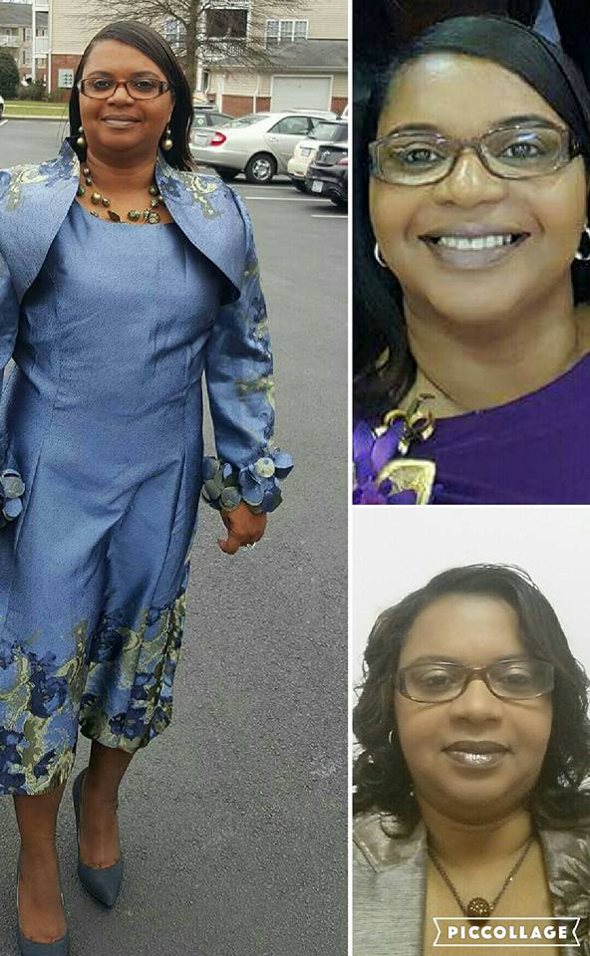

FIRST LADY REV. DOROTHY PEGUES

Slide 7
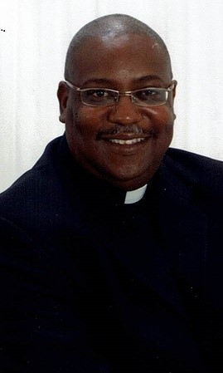
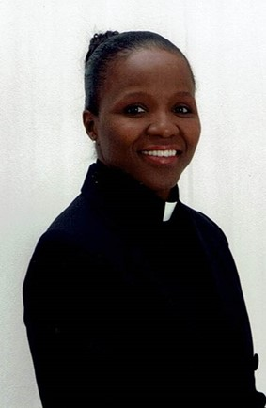

DOING MINISTRY TOGETHER
REV. FREDRICK AND MIN. TINA PEGUES

Slide 8
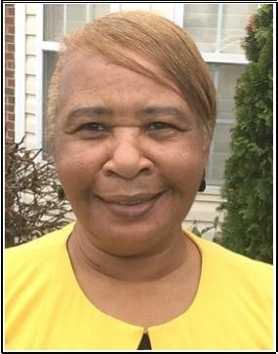

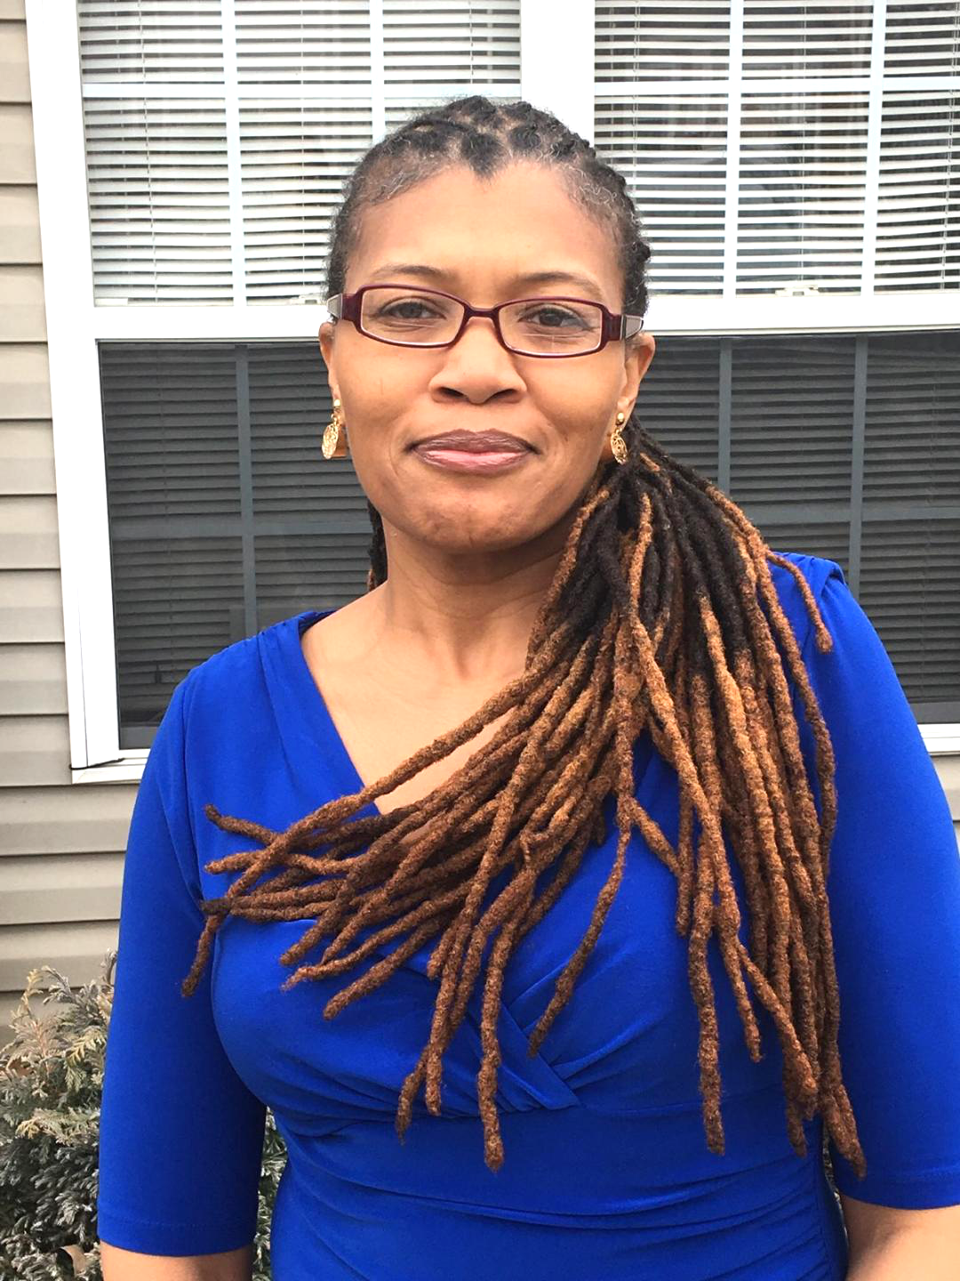
THE DYNAMIC MOTHER/DAUGHTER DUO
REV. MARY WILLIS REV. KAREN WILLIS

Slide 9
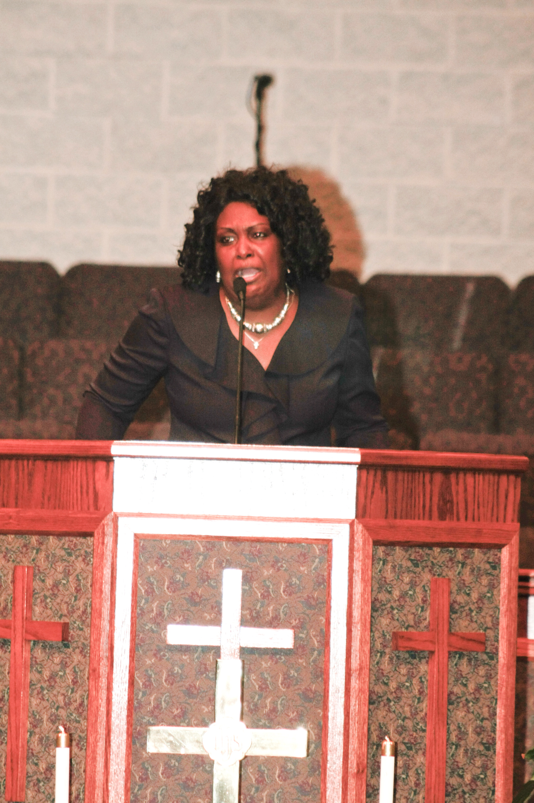
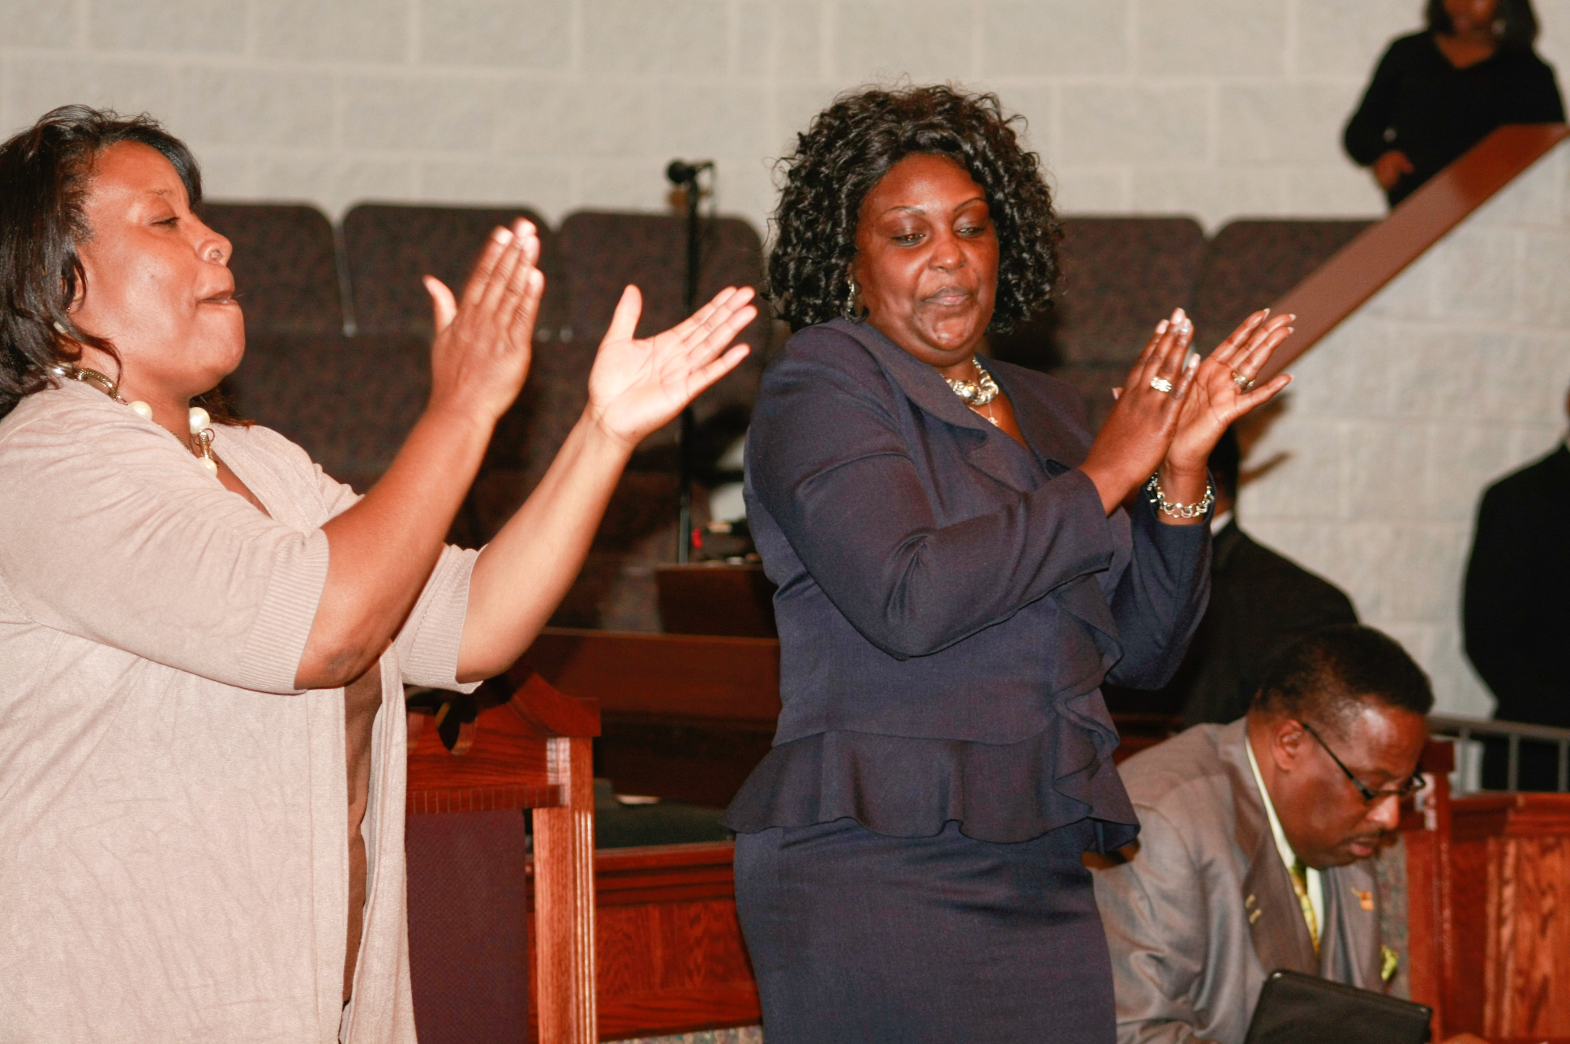
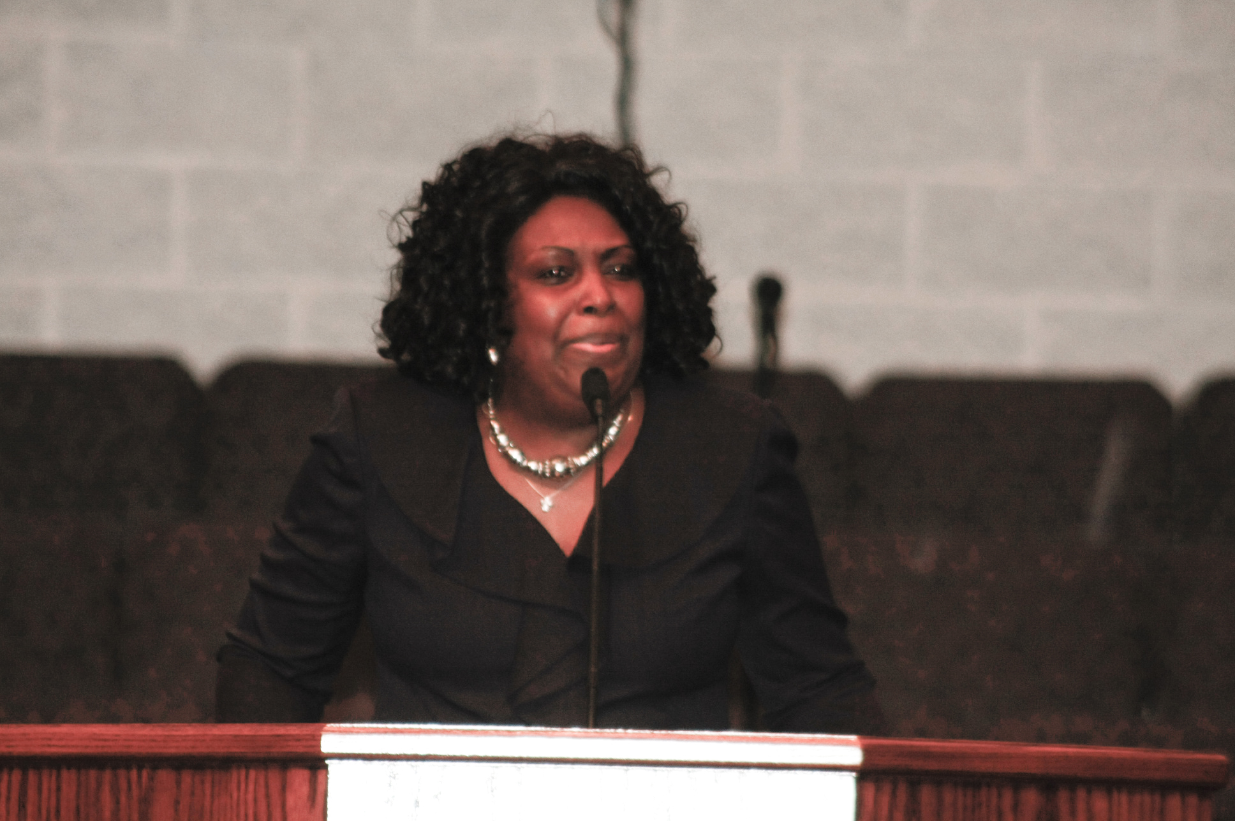
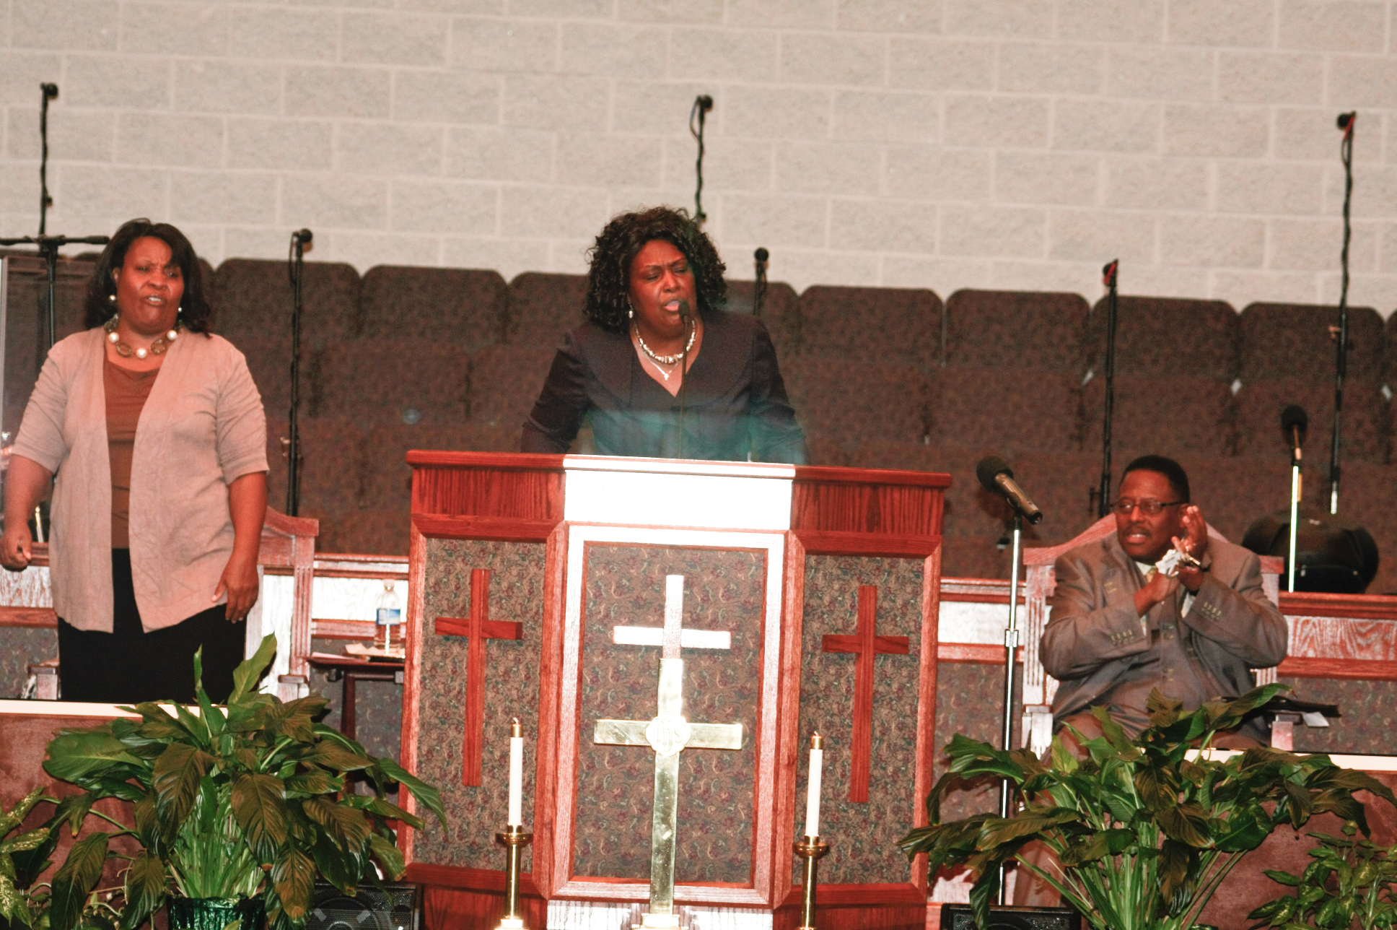

MINISTER SUE J. ROBBINS
MY SOUL LOOKS BACK AND WONDER HOW I GOT OVER

Slide 10

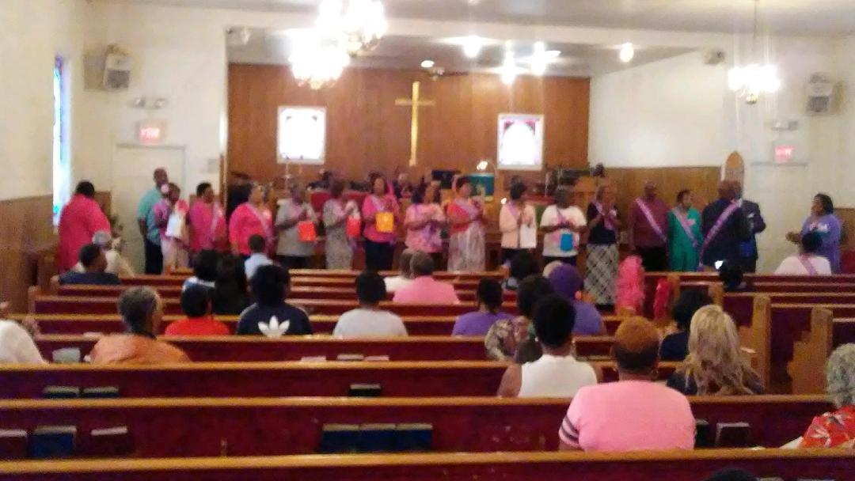
CANCER SURVIVORS

Slide 11
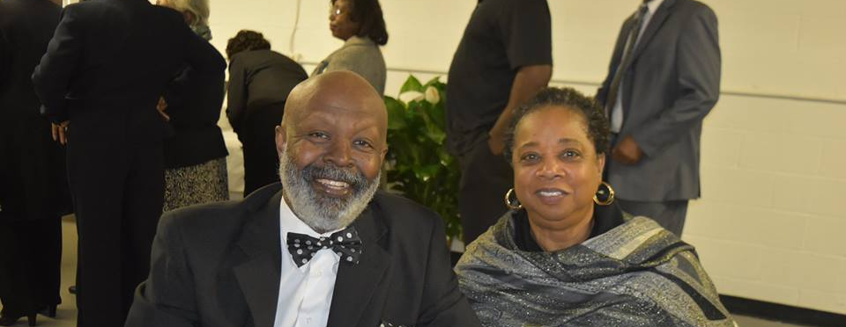

Slide 12
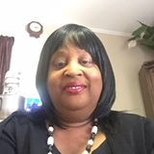

I’M A SURVIVOR!

Slide 13


I’M A SURVIVOR!

Slide 14
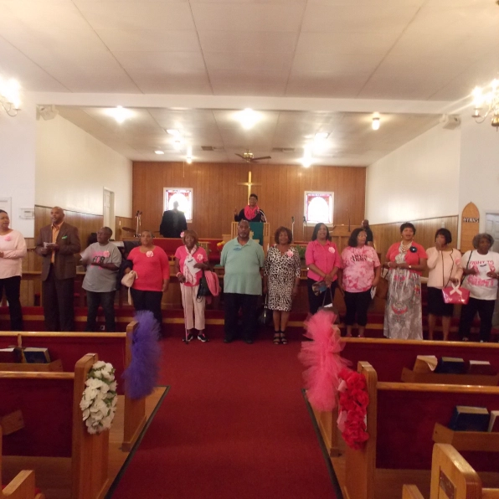
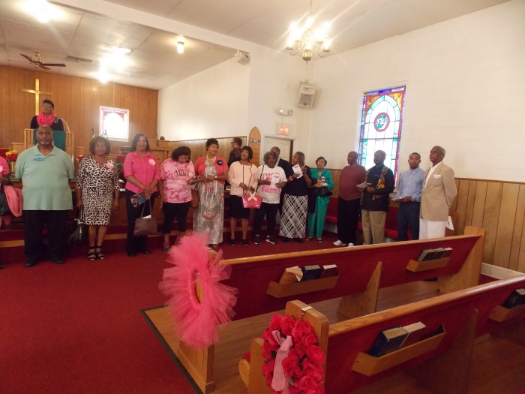
Honoring Cancer Survivors

Slide 15
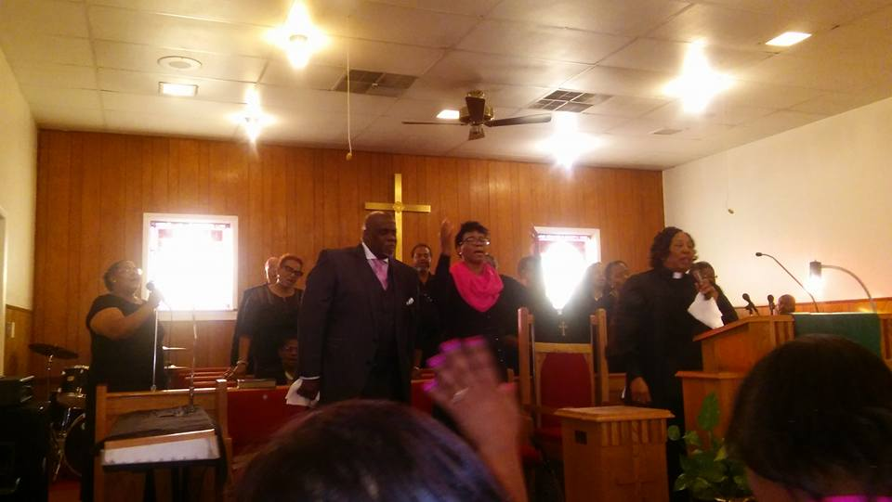

Slide 16
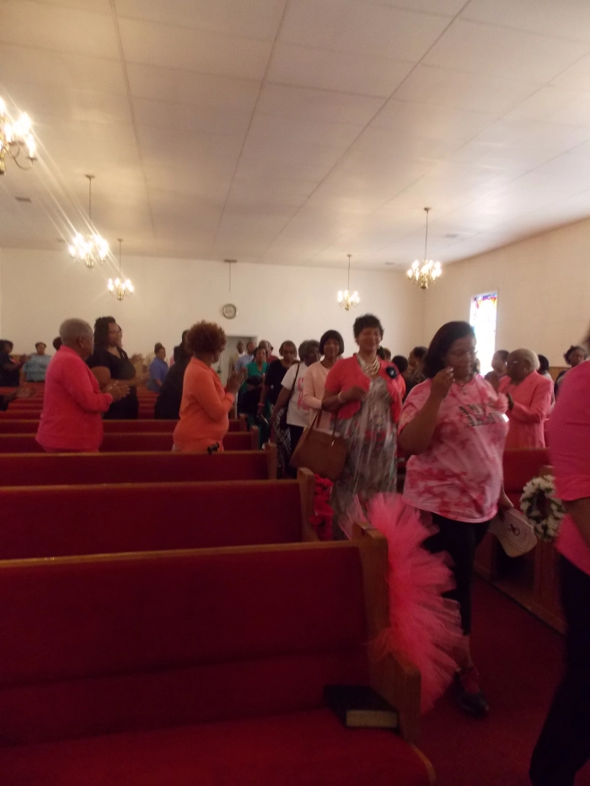
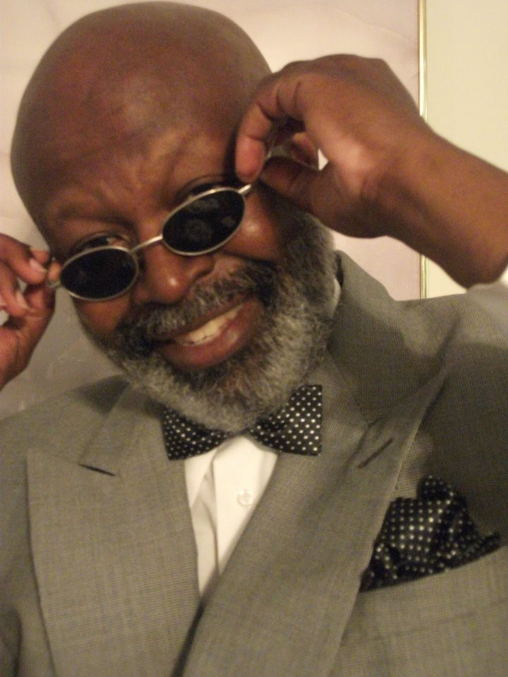
I’M A SURVIVOR!

Slide 17
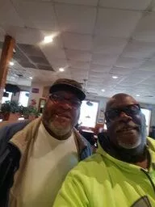
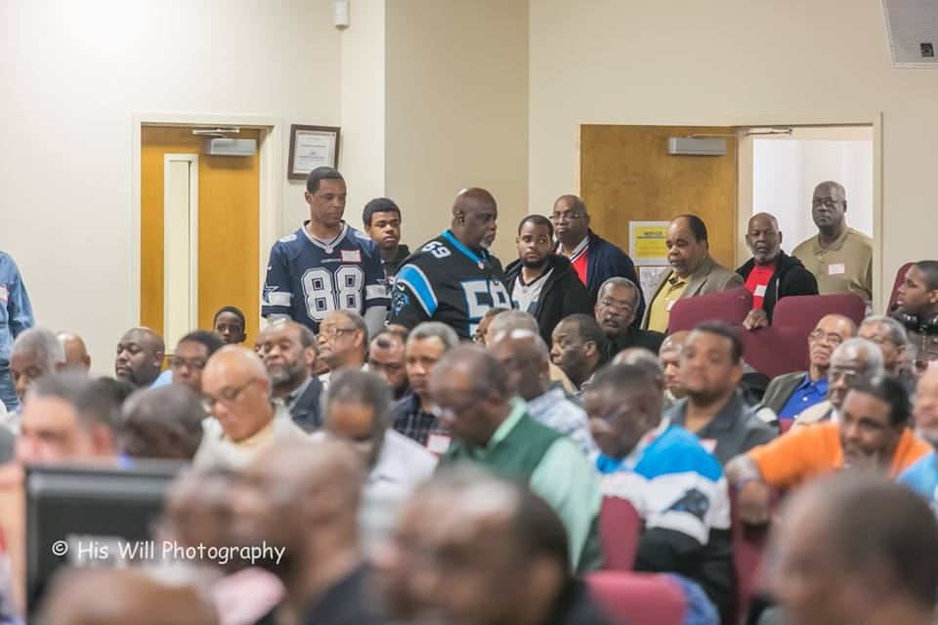
Men's Conference, Gastonia, NC 2/24/18

Slide 18
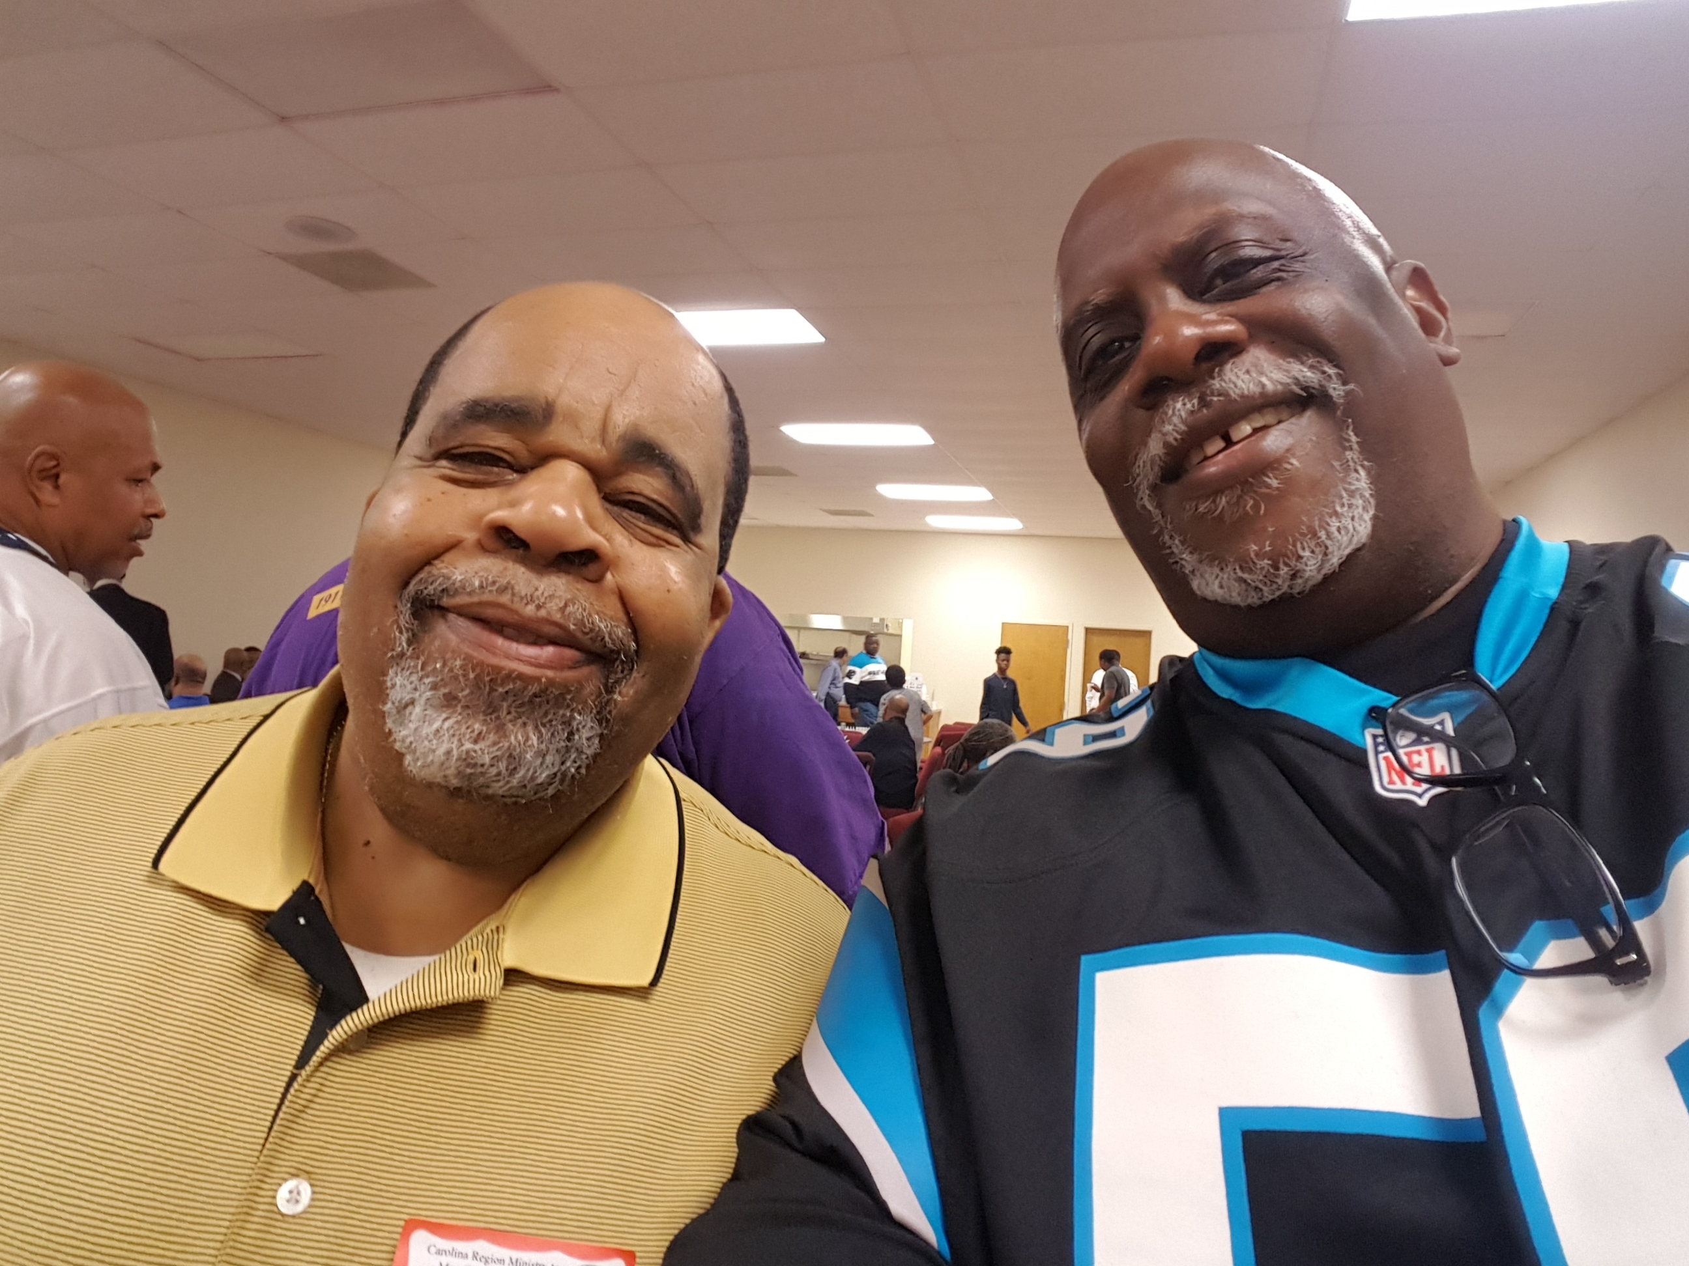
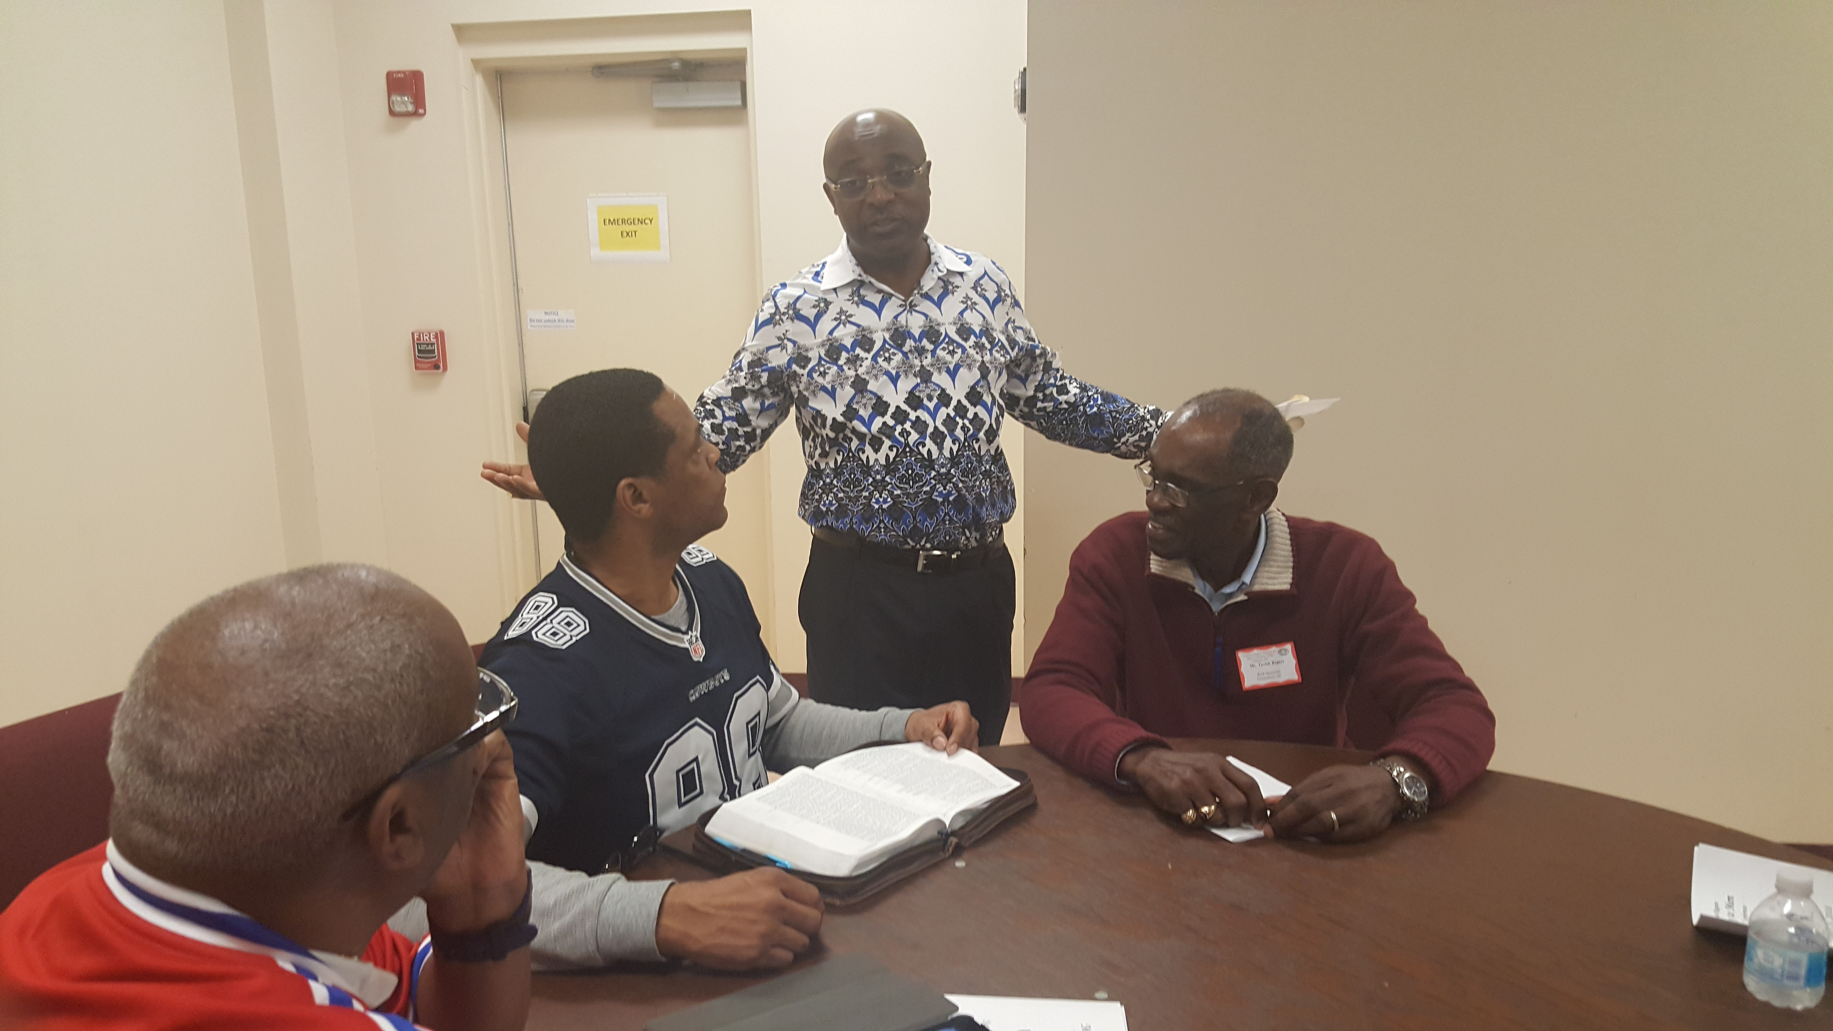

Slide 19
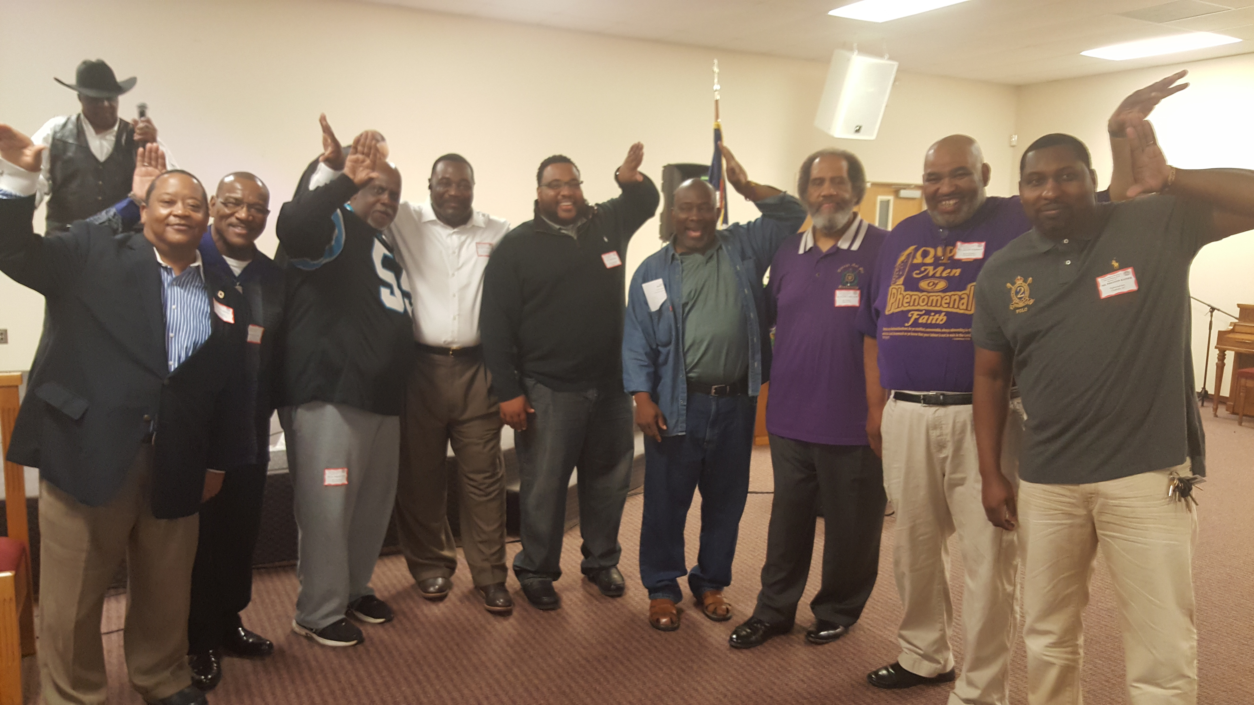
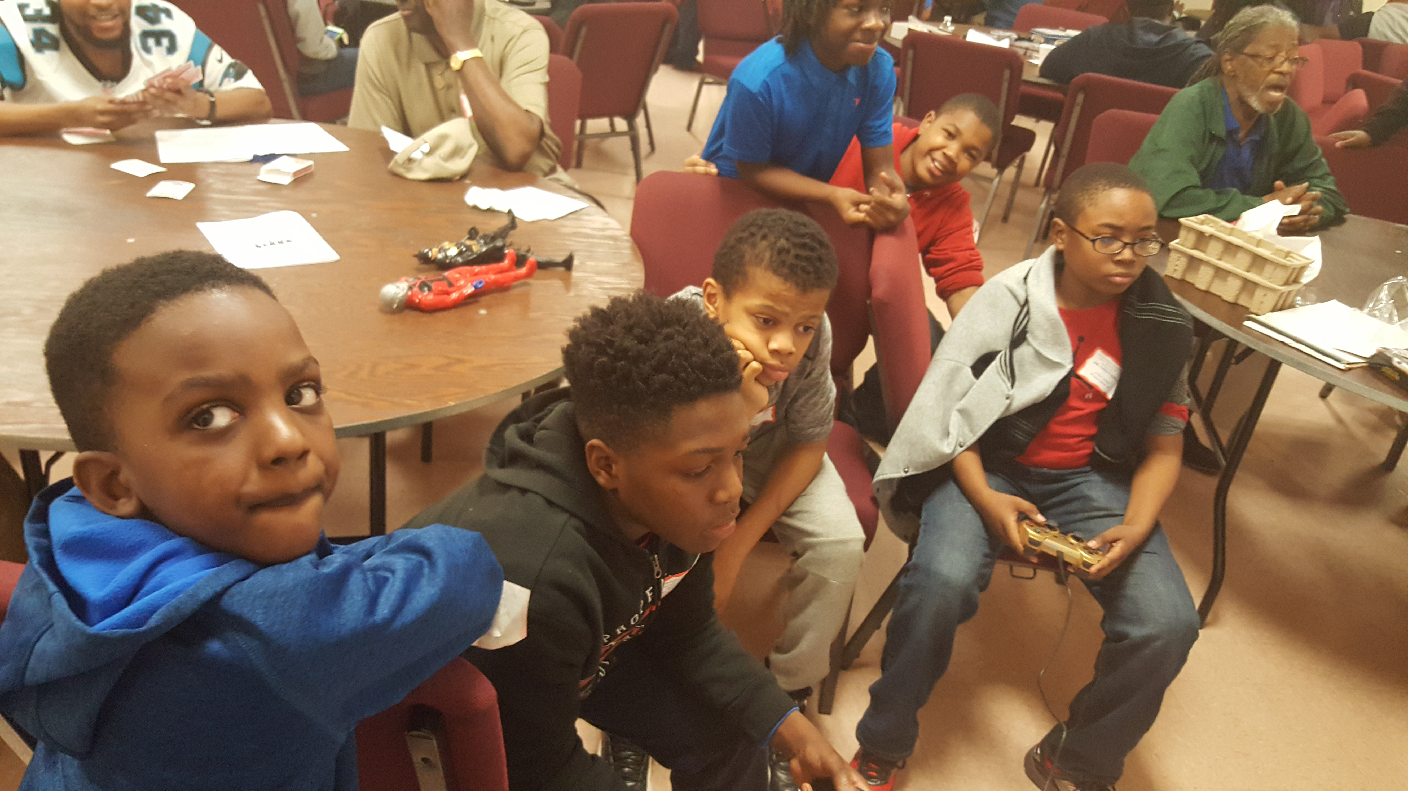

Slide 20
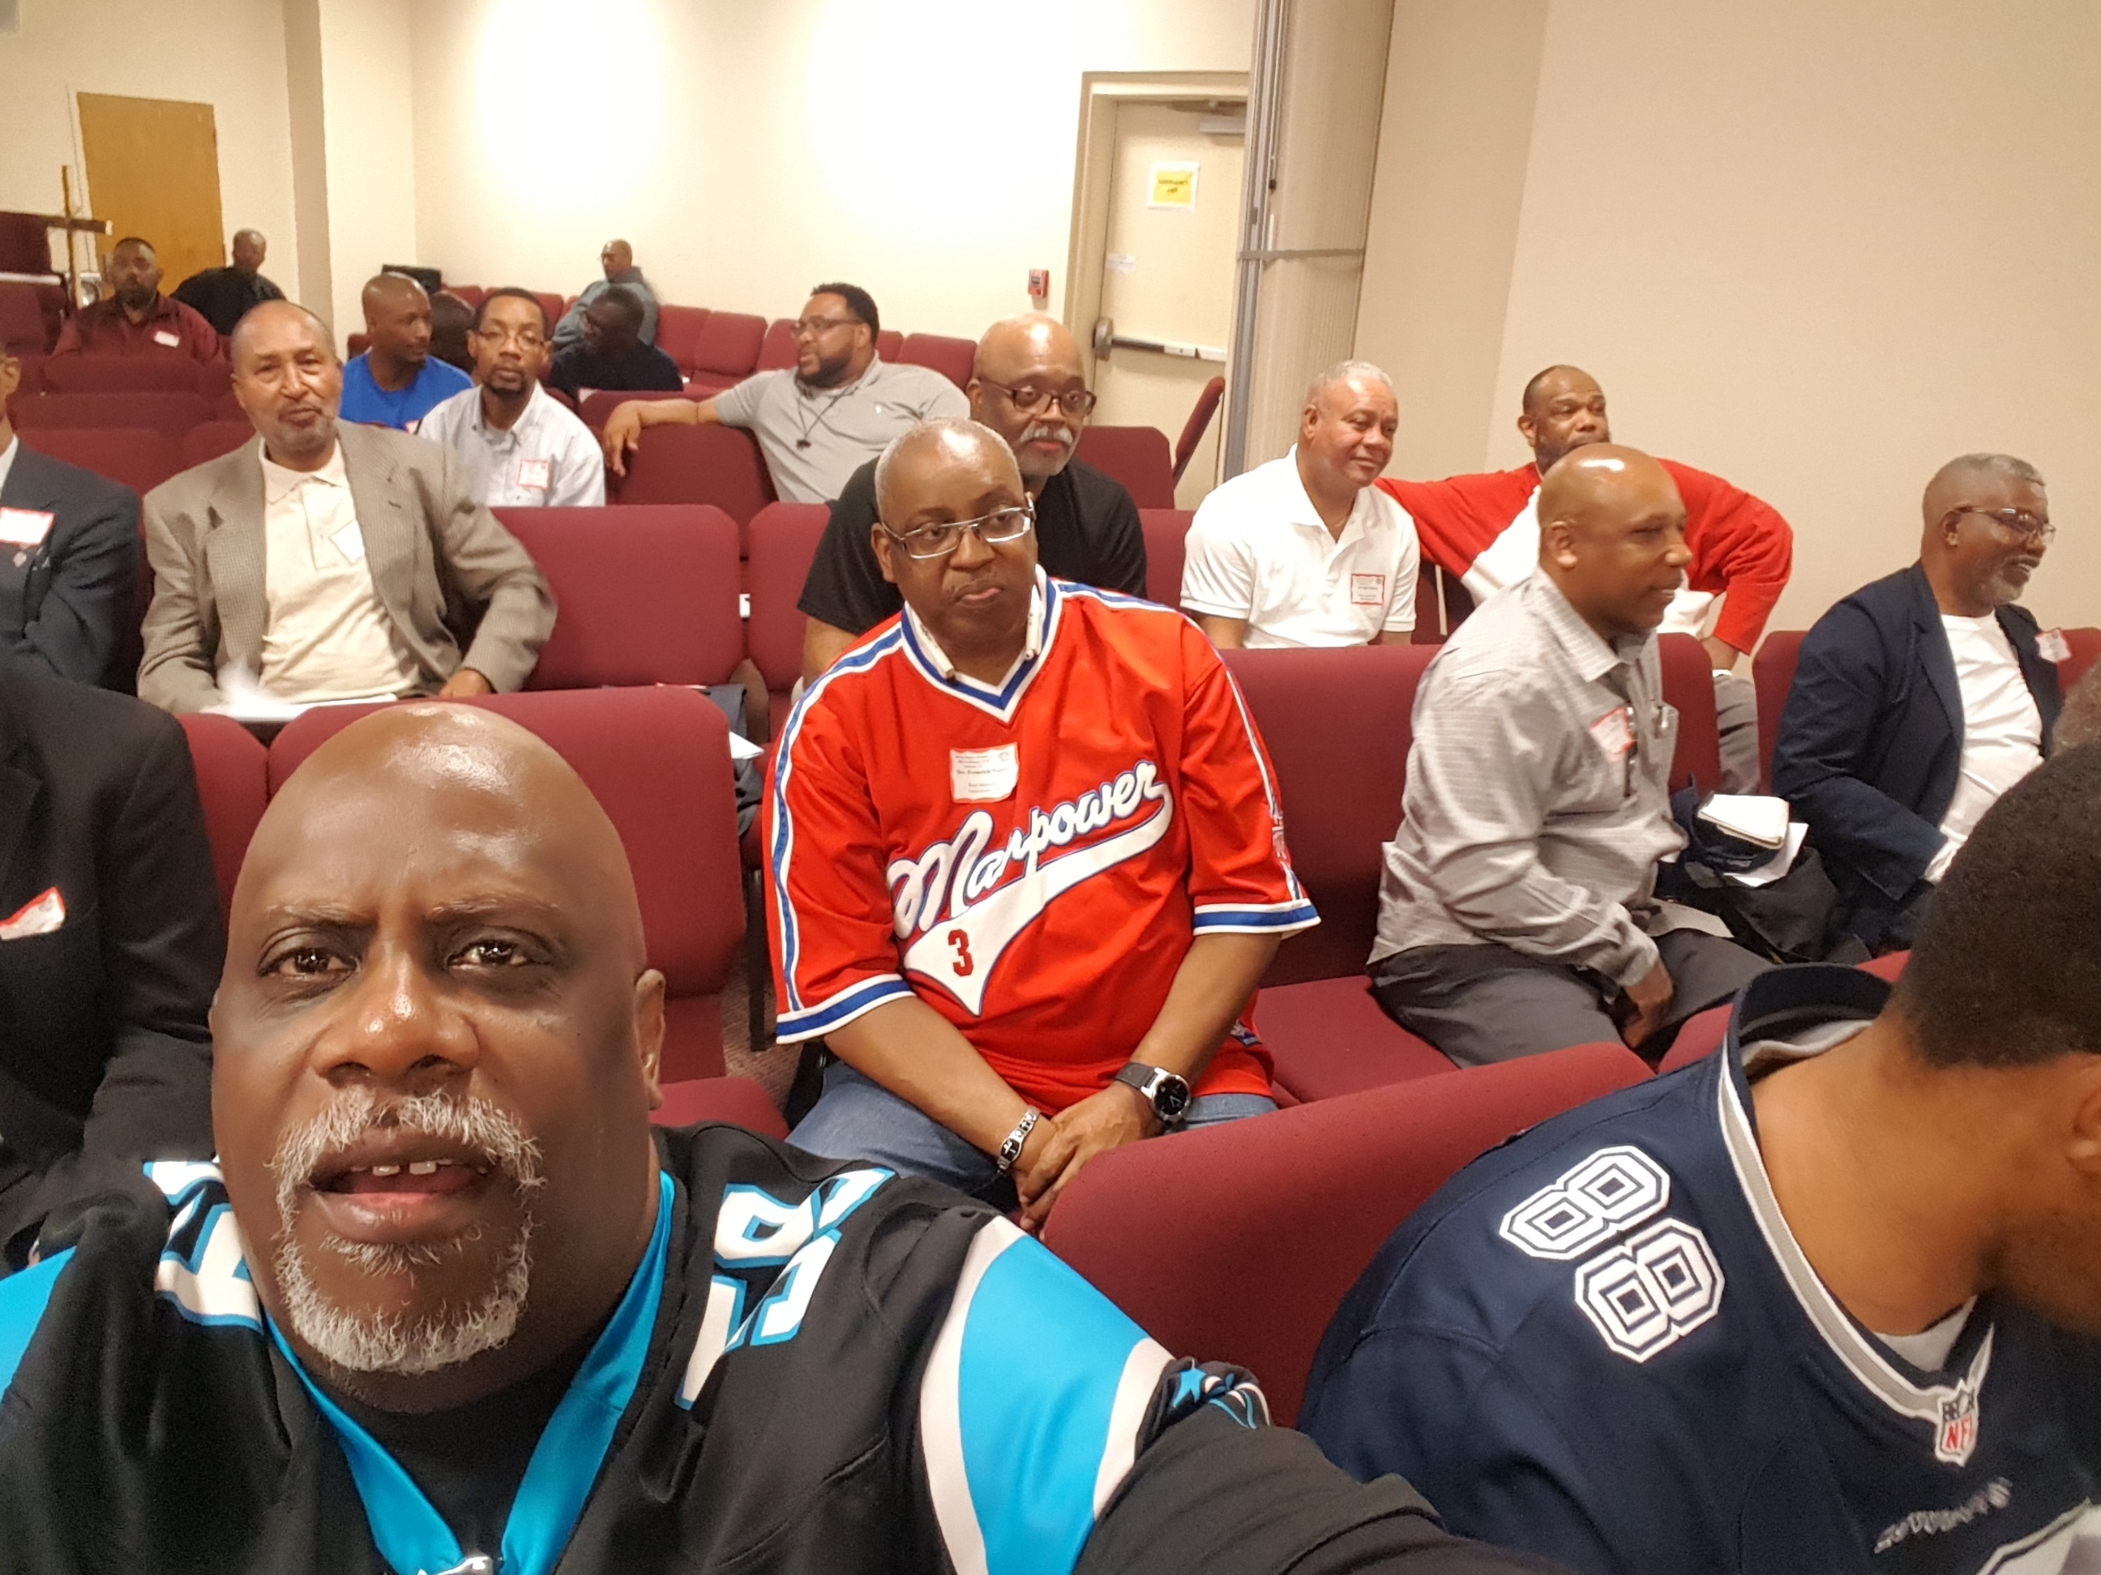

Slide 21
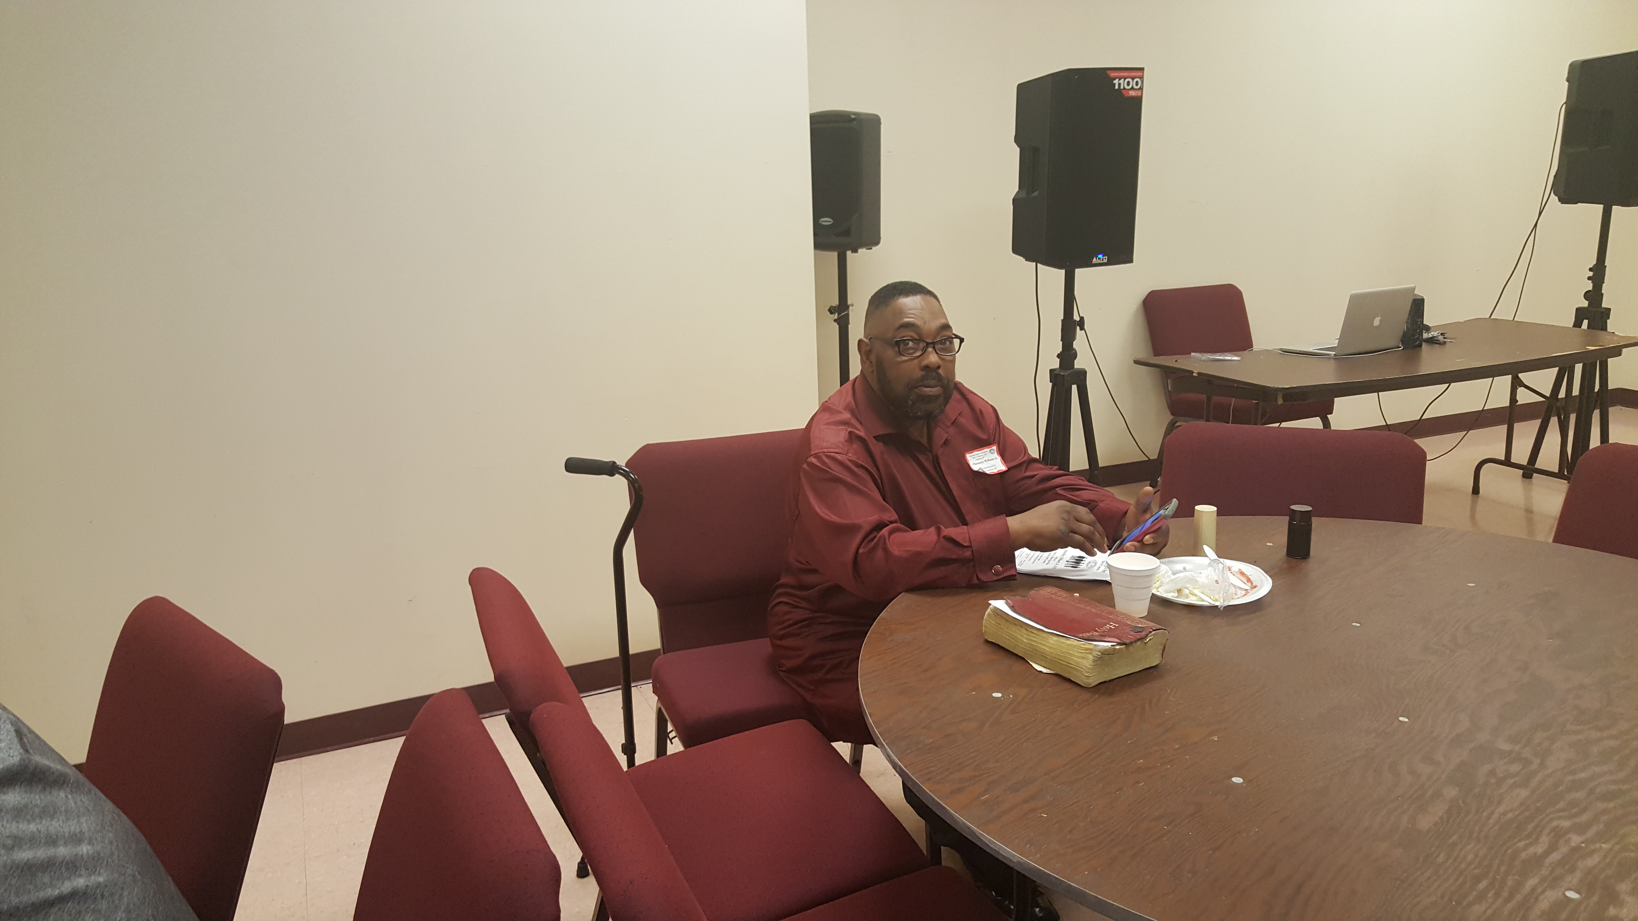

Slide 22
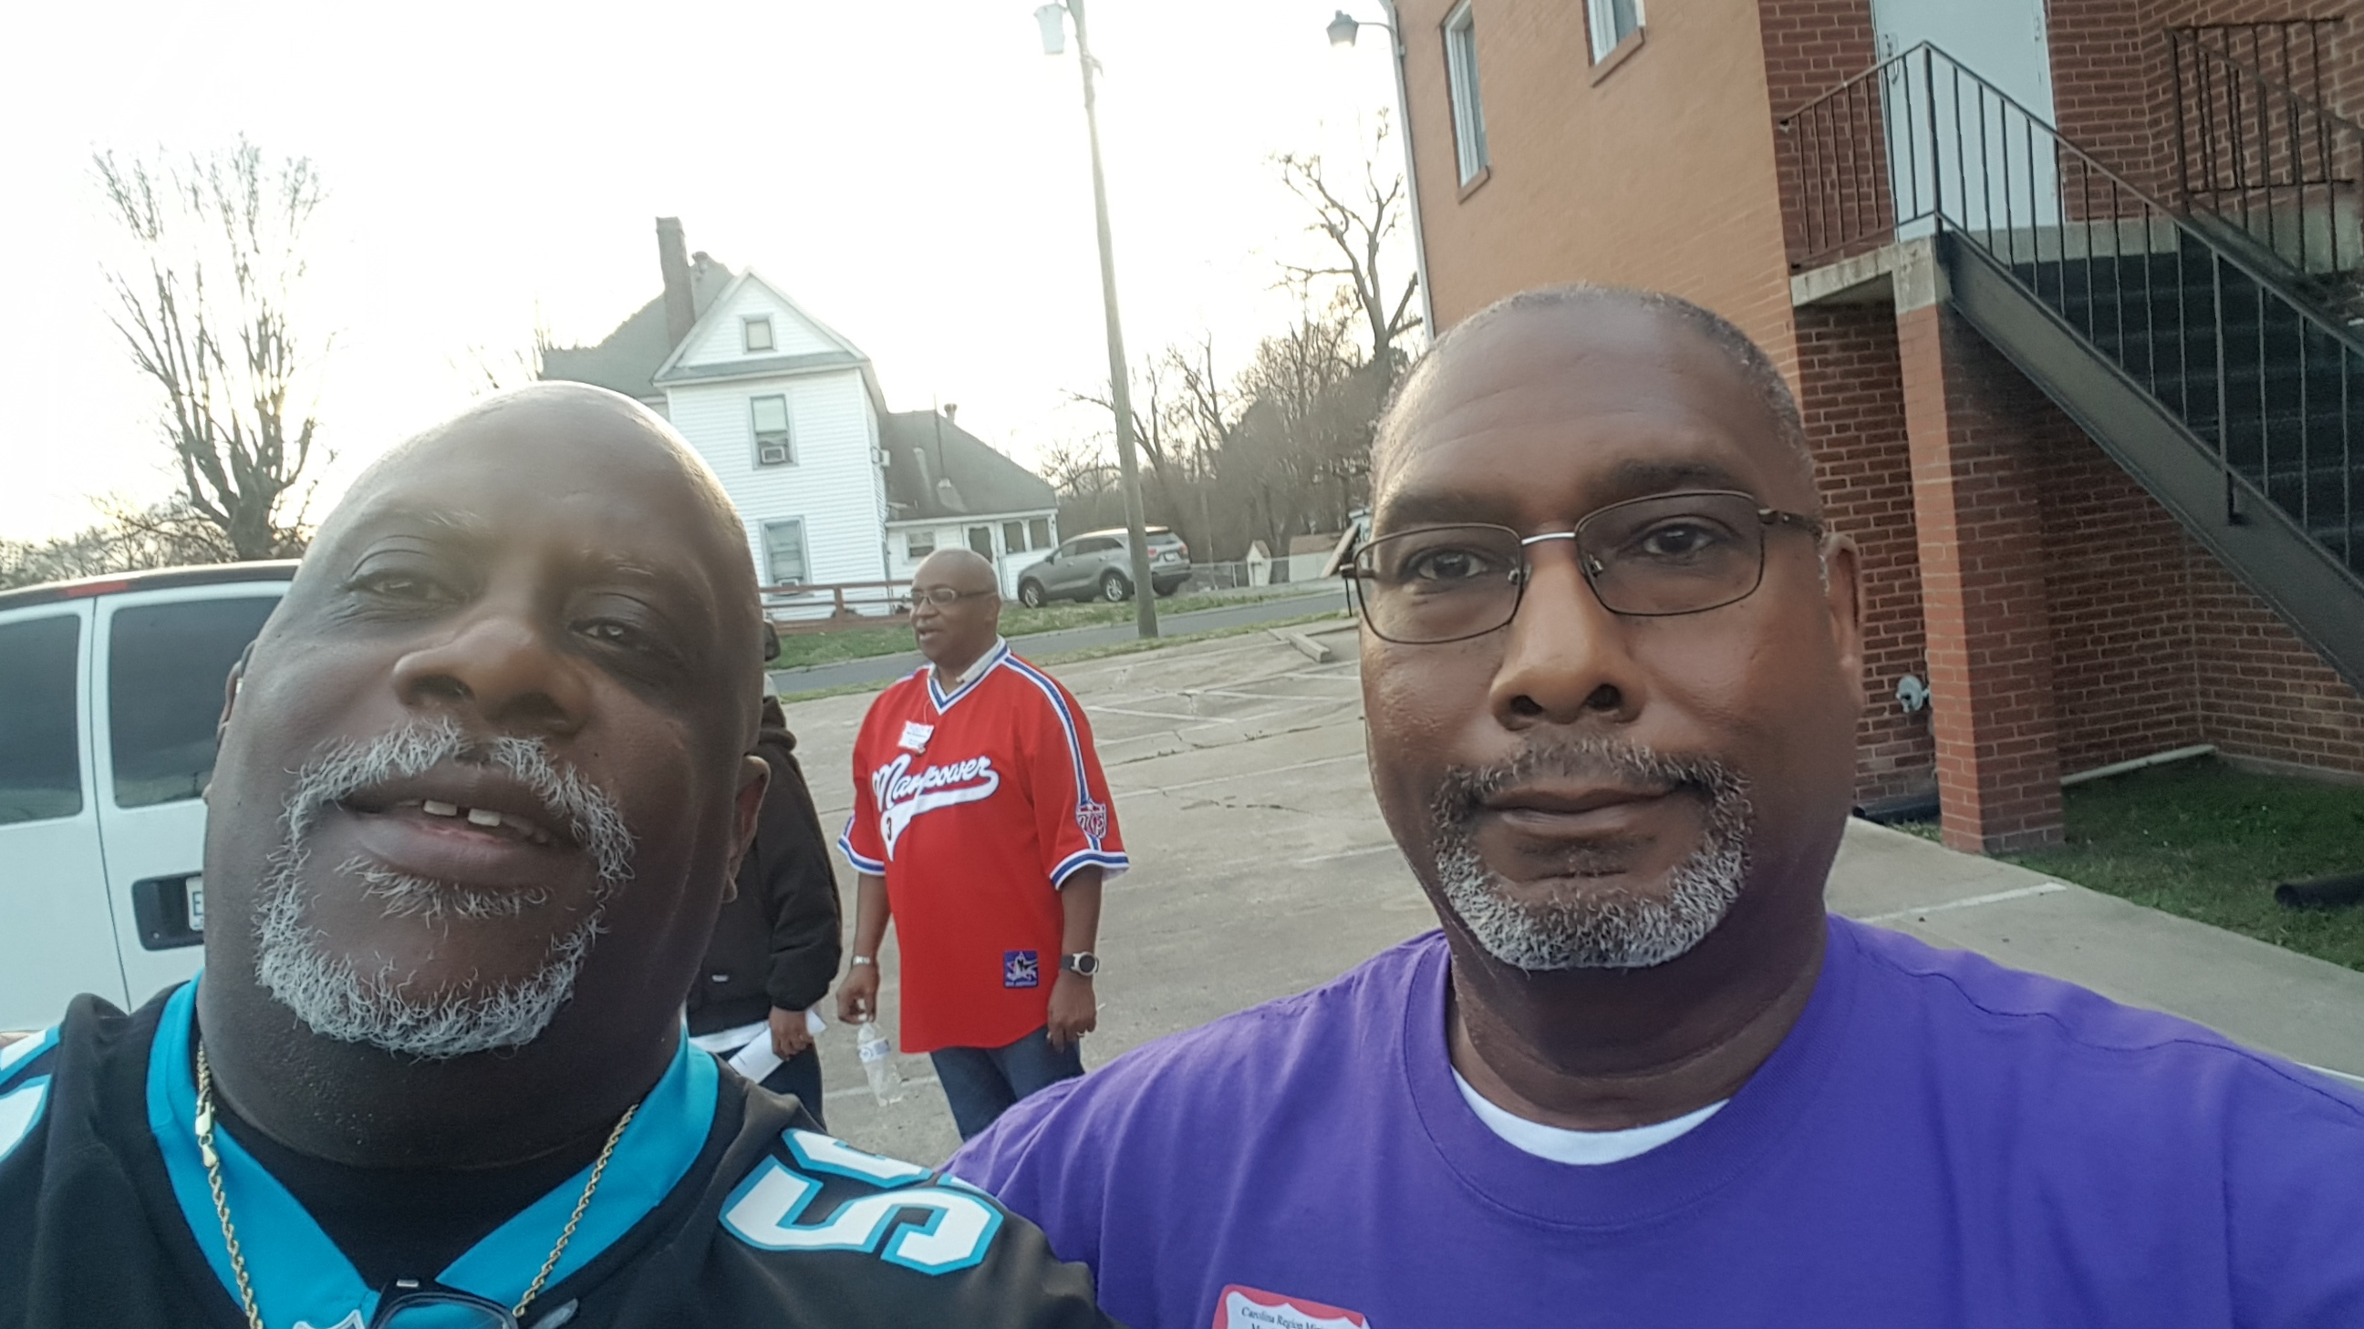

Slide 23
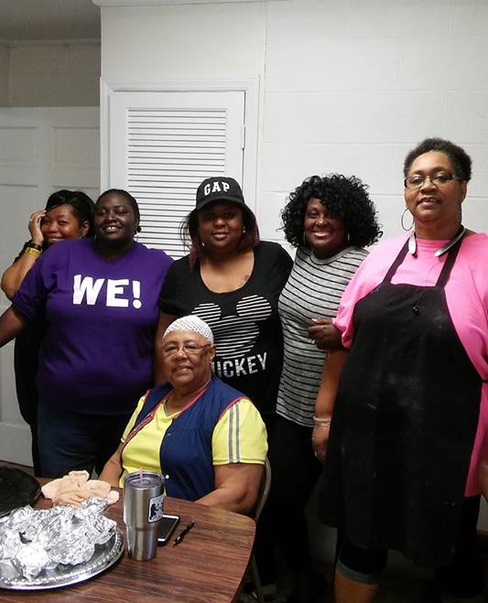


Slide 24
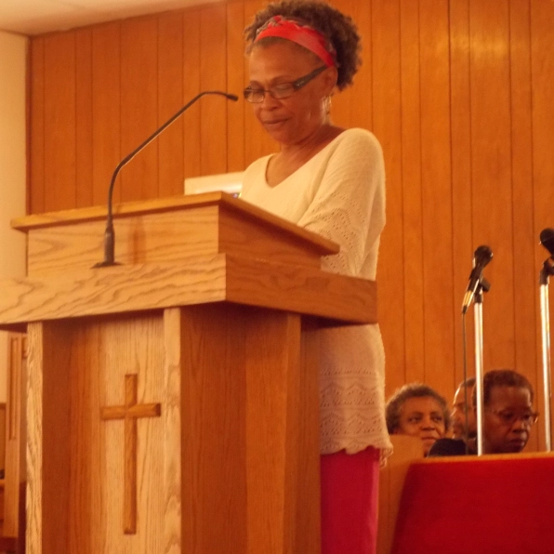
LAY COUNCIL,
SISTER MILDRED SUMMERS

Slide 25
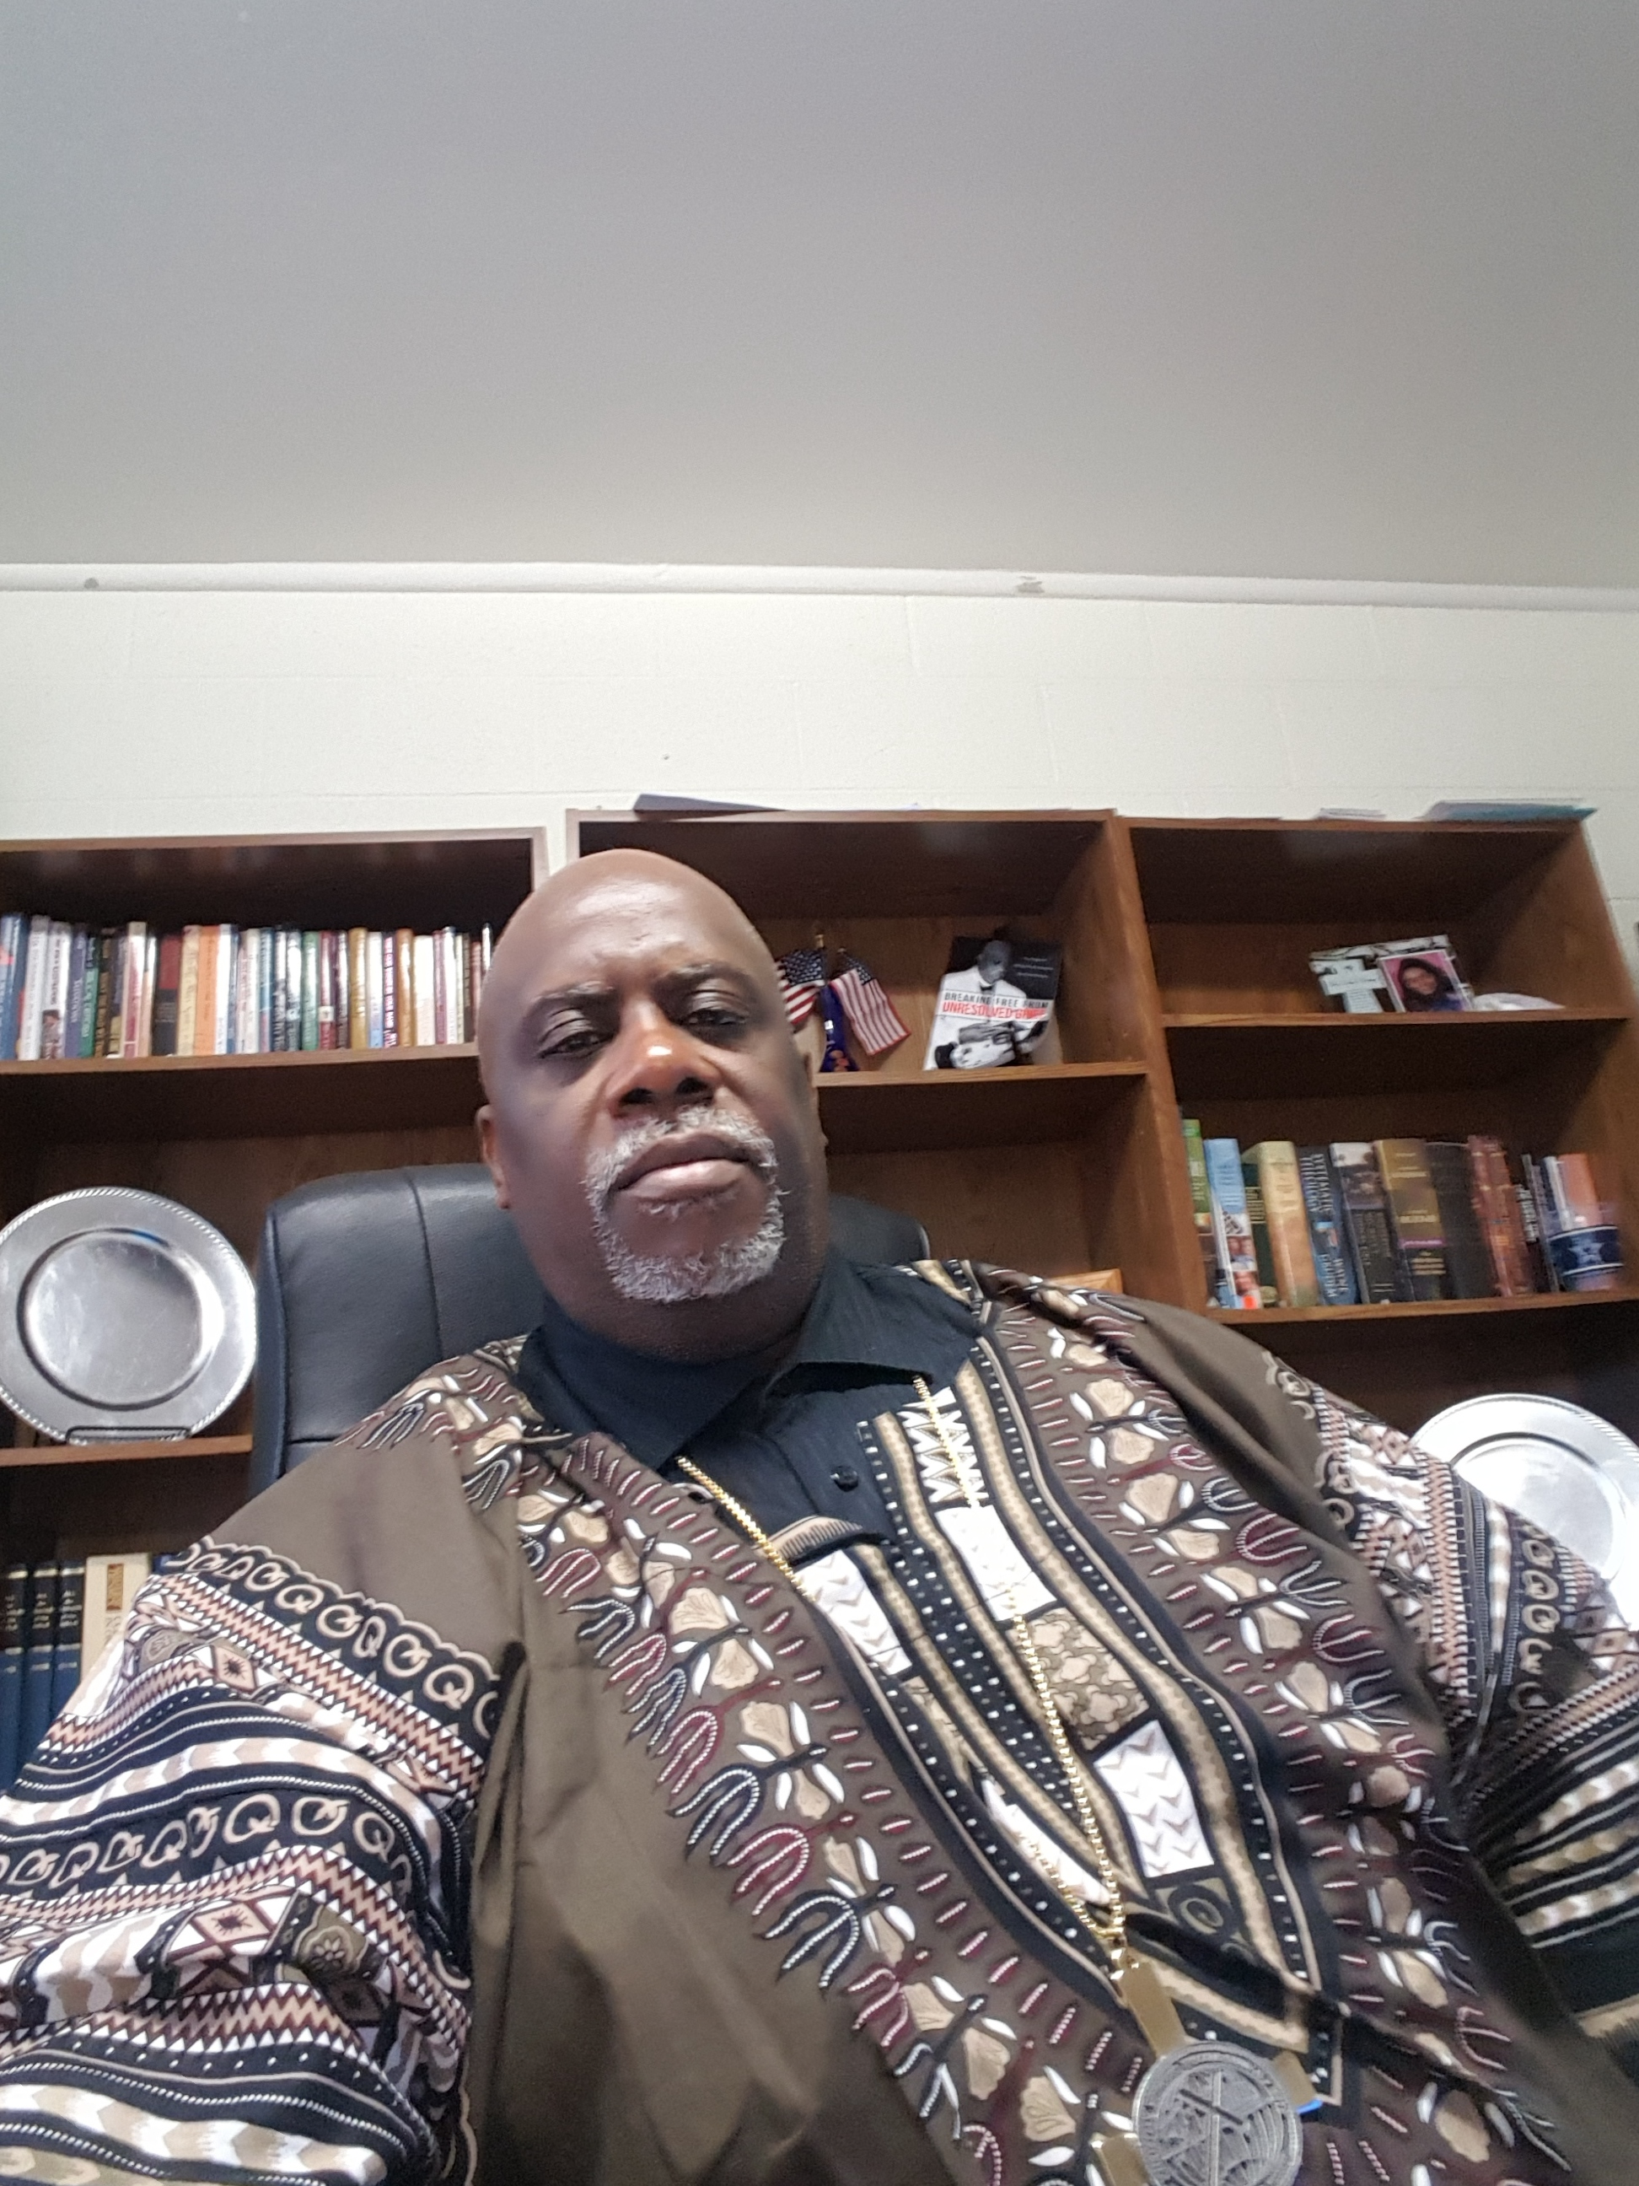
BLACK HISTORY MONTH: CELEBRATING OUR HERITAGE

Slide 26
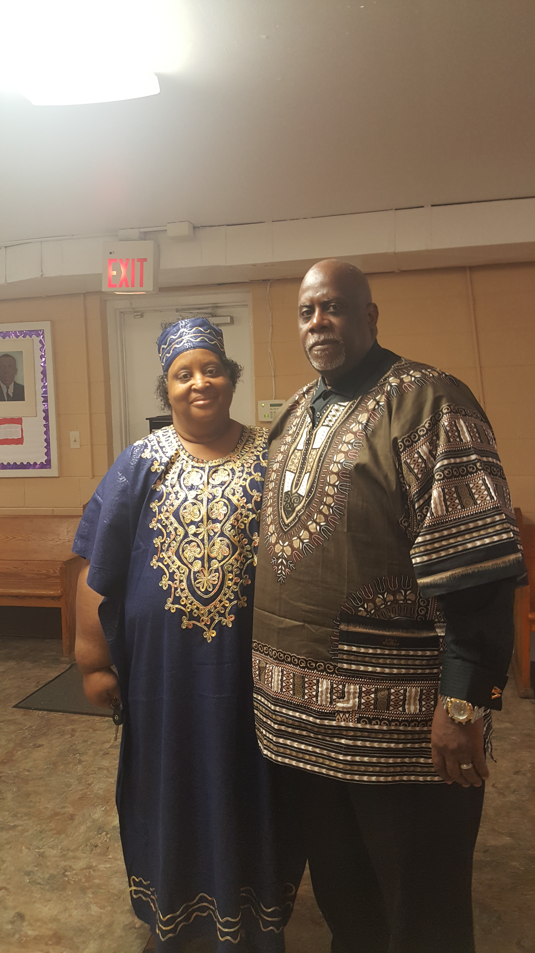

Slide 27
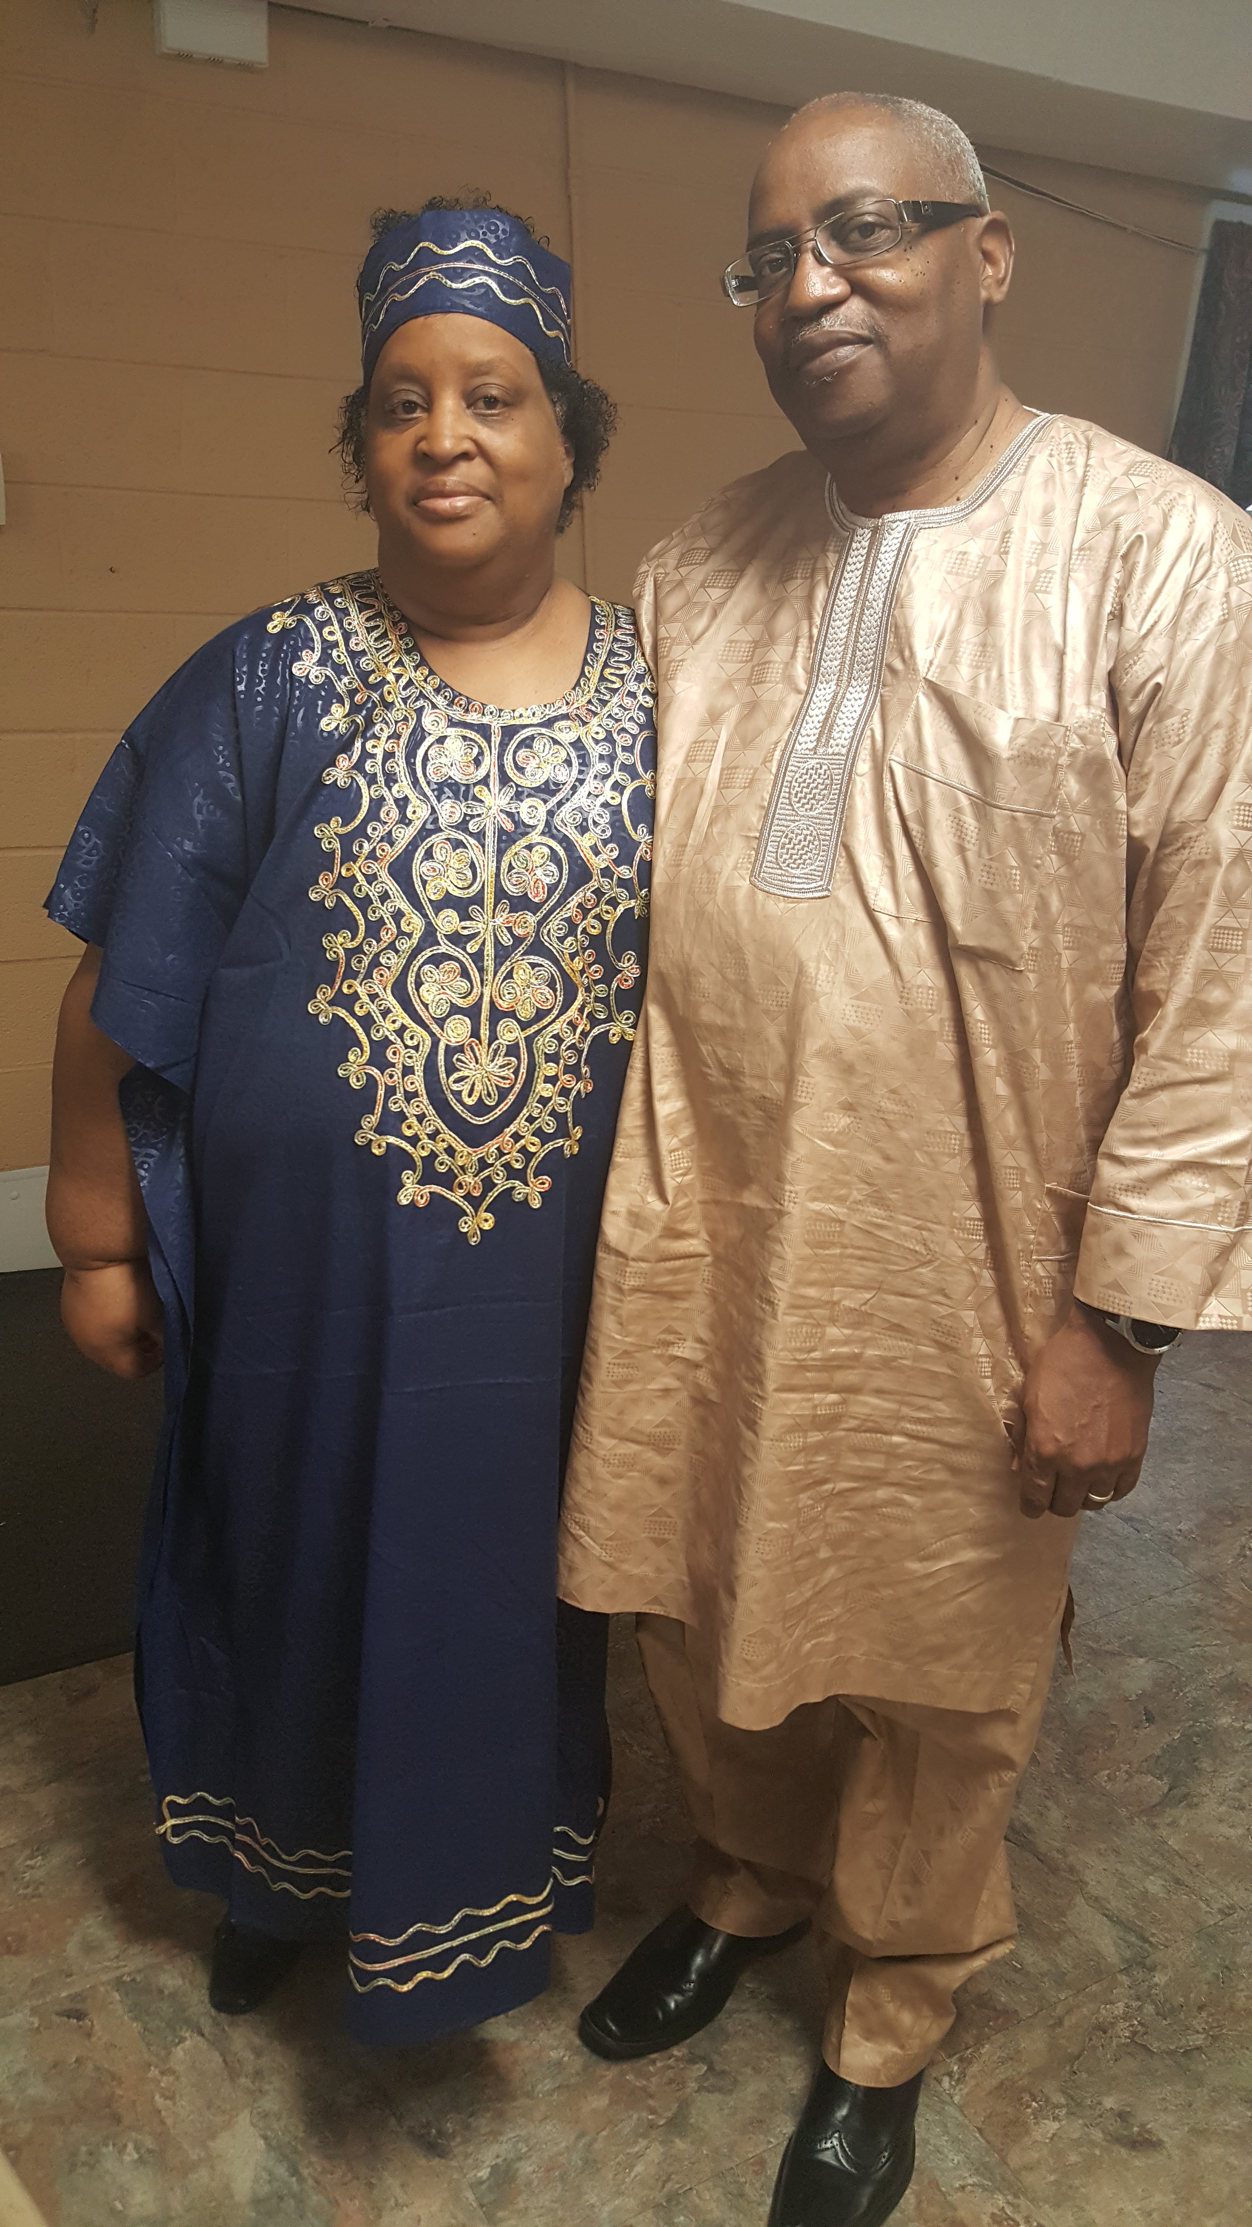

Slide 28
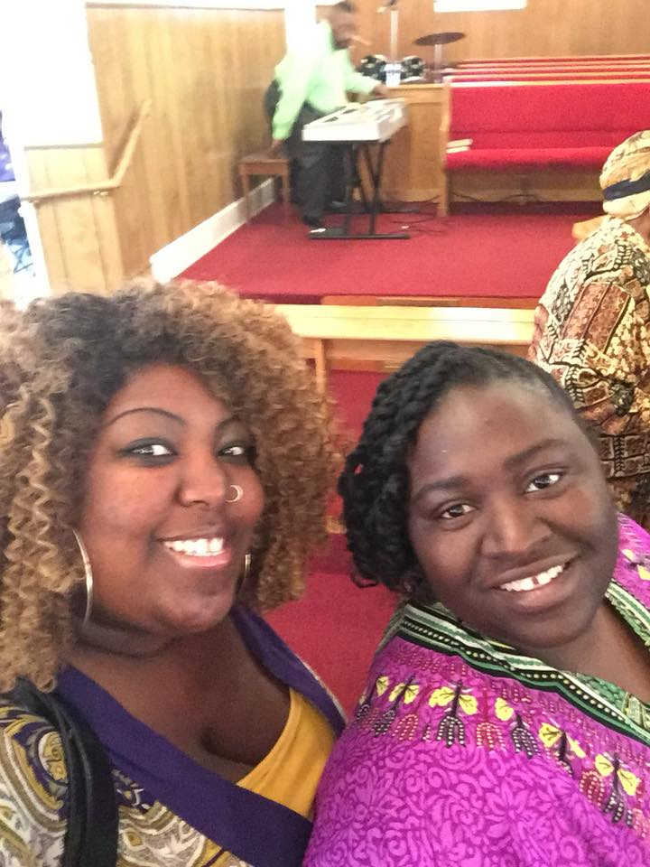

Slide 29
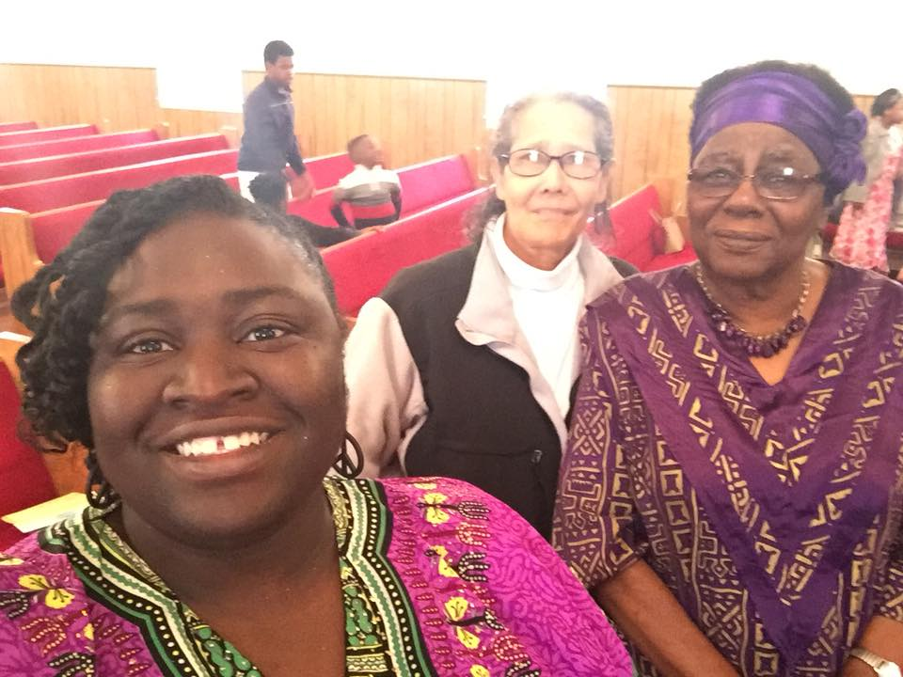

Slide 30
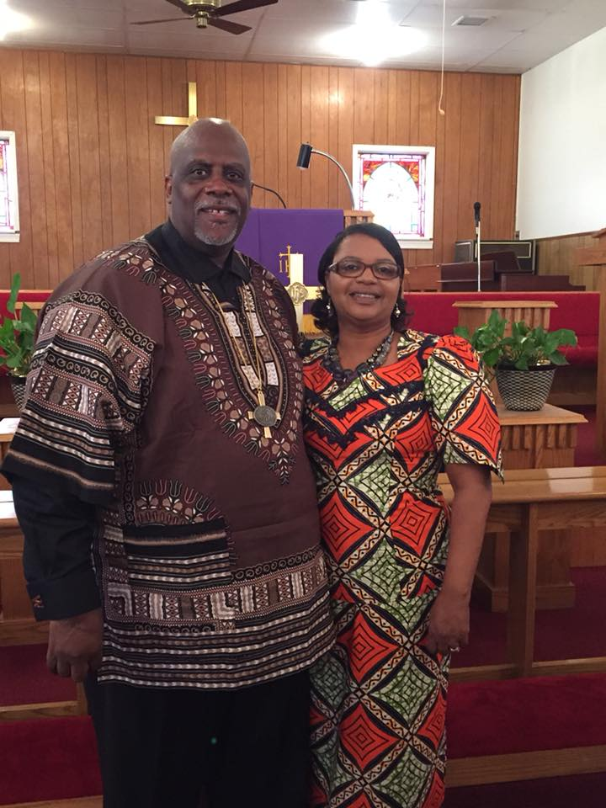

Slide 31
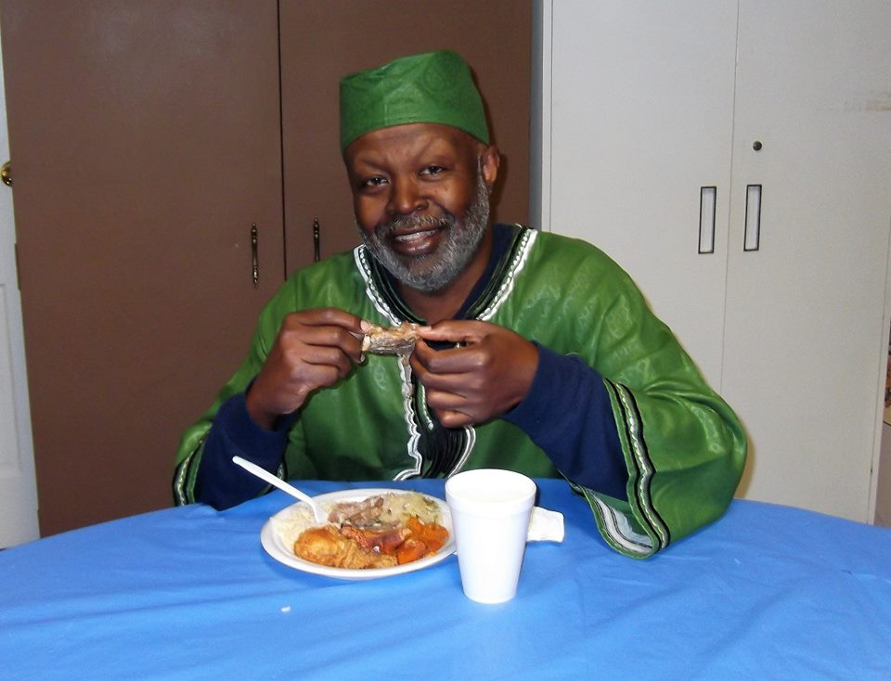

Slide 32
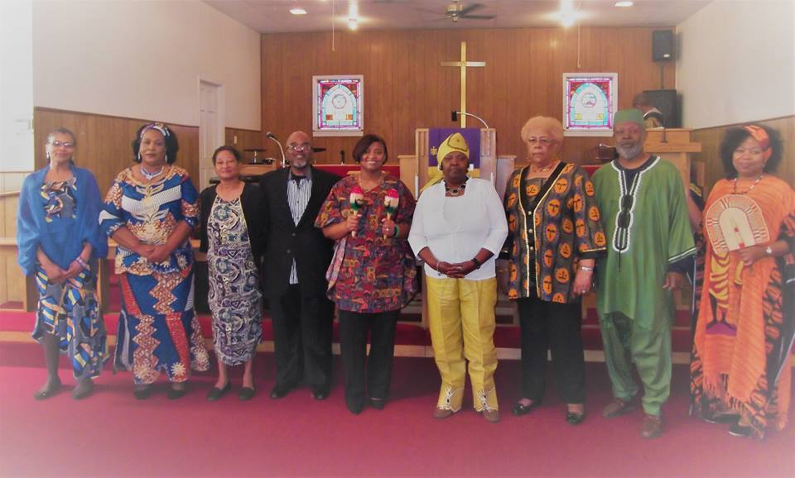

Slide 33
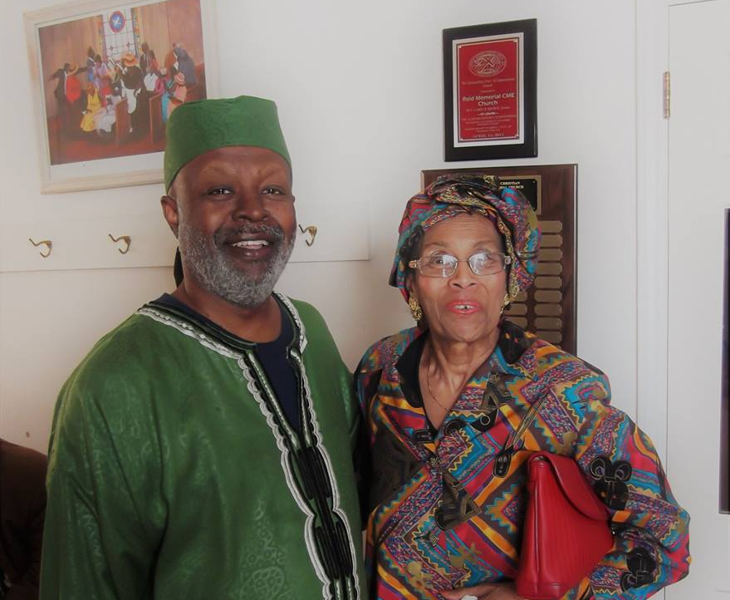

Slide 34
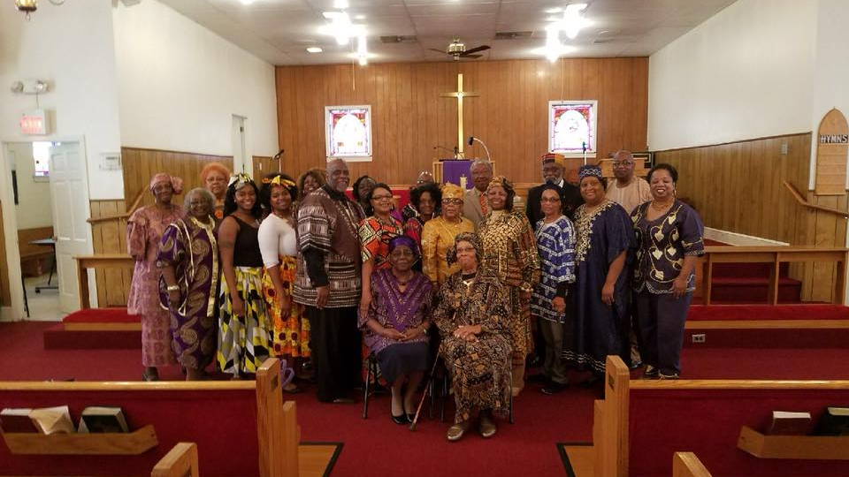

Slide 35
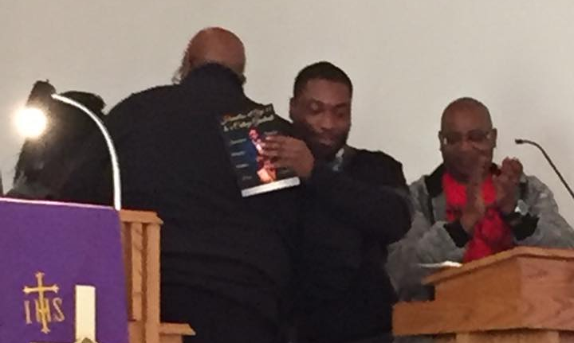

Slide 36
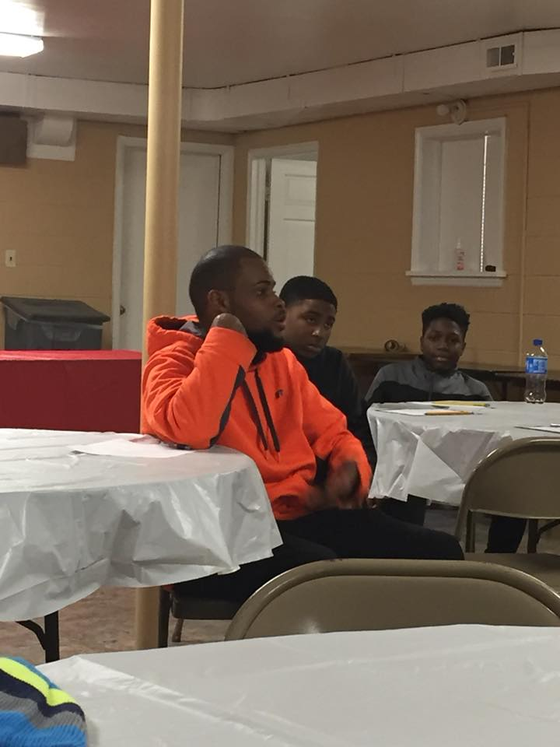
YOUTH AND YOUNG ADULT FELLOWSHIP WITH PASTOR: “A PIZZA YOUR MIND!”

Slide 37
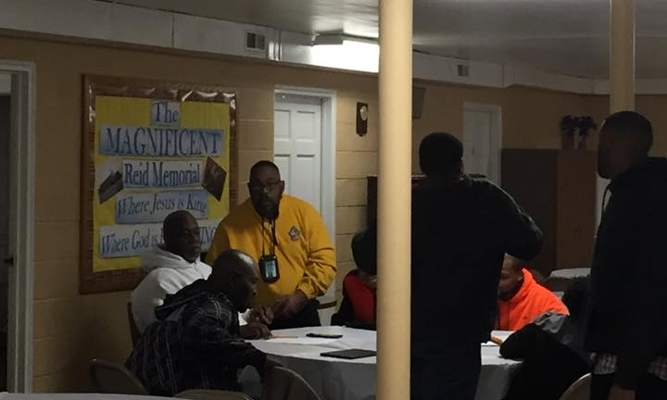

Slide 38
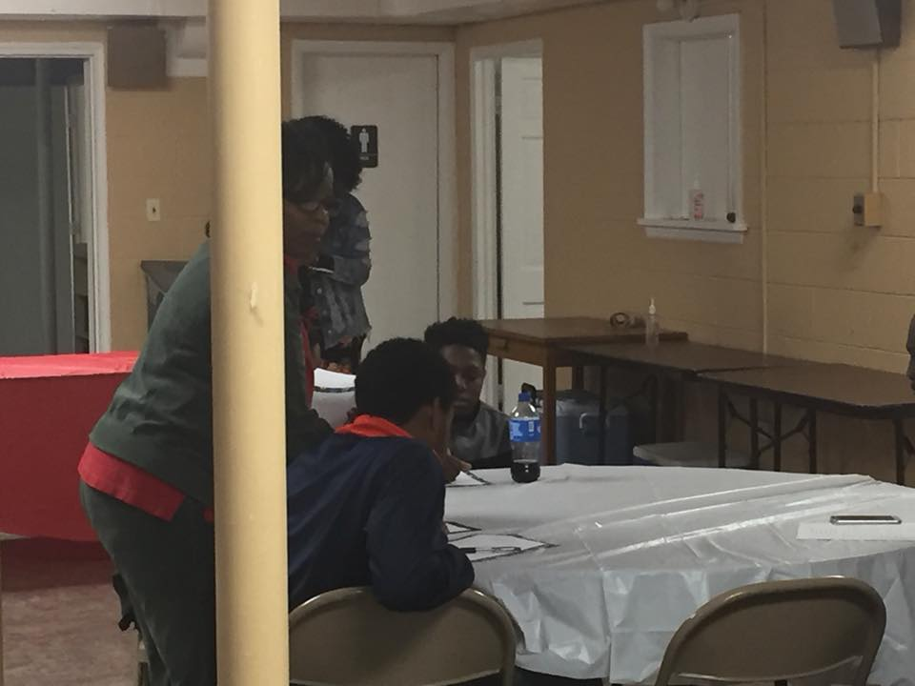

Slide 39


Slide 40

MINISTRIES BEING BIRTHED…………

Slide 41

MEN WITH BROOMS!

Slide 42


Slide 43

FISHING!!! YEAH!

Slide 44

SUPER BOWL TEA 2017

Slide 45


Slide 46


Slide 47


Slide 48


Slide 49


Slide 50

PITTSBURGH STEELERS

Slide 51

DALLAS COWBOYS; WE DEM’BOYZ!

Slide 52

CAROLINA PANTHERS

Slide 53

ROOOOOAR!!!

Slide 54

COLLEGE TEAM NIGHT

Slide 55

MINISTER JOHN EASTERLING
UNCG
2

Slide 56

YOUTH SUNDAY: MINISTER TINA PEGUES

Slide 57


Slide 58


Slide 59


Slide 60


